Slide 1

21CSC203P -Advanced Programming Practice Unit II

Slide 2
Outline of the Presentation
Object and Classes; Constructor; Data types; Variables; Modifier and Operators
Structural Programming Paradigm: Branching, Iteration, Decision making, and Arrays
Procedural Programming Paradigm: Characteristics; Function Definition; Function Declaration and Calling; Function Arguments
Object-Oriented Programming Paradigm: Abstraction; Encapsulation; Inheritance; Polymorphism; Overriding
Interfaces: Declaring, Implementing; Extended and Tagging
Package: Package Creation
10-08-2023
Dr.R.Kayalvizhi, Assistant Professor / NWC
2

Slide 3
Java platform features
Compiled and Interpreter:- has both Compiled and Interpreter Feature Program of java is First Compiled and Then it is must to Interpret it. First of all The Program of java is Compiled then after Compilation it creates Bytes Codes rather than Machine Language. Then After Bytes Codes are Converted into the Machine Language is Converted into the Machine Language with the help of the Interpreter So For Executing the java Program First of all it is necessary to Compile it then it must be Interpreter
Platform Independent:- Java Language is Platform Independent means program of java is Easily transferable because after Compilation of java program bytes code will be created then we have to just transfer the Code of Byte Code to another Computer. This is not necessary for computers having same Operating System in which the code of the java is Created and Executed After Compilation of the Java Program We easily Convert the Program of the java top the another Computer for Execution.
Object-Oriented:- We Know that is purely OOP Language that is all the Code of the java Language is Written into the classes and Objects So For This feature java is Most Popular Language because it also Supports Code Reusability, Maintainability etc.
10-08-2023
Dr.R.Kayalvizhi, Assistant Professor / NWC

Slide 4
Java platform features
Robust and Secure:- The Code of java is Robust and Means of first checks the reliability of the code before Execution When We trying to Convert the Higher data type into the Lower Then it Checks the Demotion of the Code the It Will Warns a User to Not to do this So it is called as Robust. Secure : When We convert the Code from One Machine to Another the First Check the Code either it is Effected by the Virus or not or it Checks the Safety of the Code if code contains the Virus then it will never Executed that code on to the Machine.
Distributed:- Java is Distributed Language Means because the program of java is compiled onto one machine can be easily transferred to machine and Executes them on another machine because facility of Bytes Codes So java is Specially designed For Internet Users which uses the Remote Computers For Executing their Programs on local machine after transferring the Programs from Remote Computers or either from the internet.
Simple Small and Familiar:- is a simple Language Because it contains many features of other Languages like c and C++ and Java Removes Complexity because it doesn’t use pointers, Storage Classes and Go to Statements and java Doesn’t support Multiple Inheritance
Multithreaded and Interactive:- Java uses Multithreaded Techniques For Execution Means Like in other in Structure Languages Code is Divided into the Small Parts Like These Code of java is divided into the Smaller parts those are Executed by java in Sequence and Timing Manner this is Called as Multithreaded In this Program of java is divided into the Small parts those are Executed by Compiler of java itself Java is Called as Interactive because Code of java Sup
Dynamic and Extensible Code:- Java has Dynamic and Extensible Code Means With the Help of OOPS java Provides Inheritance and With the Help of Inheritance we Reuse the Code that is Pre-defined and Also uses all the built in Functions of java and Classes
10-08-2023
Dr.R.Kayalvizhi, Assistant Professor / NWC

Slide 5
Java platform features
Distributed:- Java is a distributed language which means that the program can be design to run on computer networks. Java provides an extensive library of classes for communicating ,using TCP/IP protocols such as HTTP and FTP. This makes creating network connections much easier than in C/C++. You can read and write objects on the remote sites via URL with the same ease that programmers are used to when read and write data from and to a file. This helps the programmers at remote locations to work together on the same project.
Secure: Java was designed with security in mind. As Java is intended to be used in networked/distributor environments so it implements several security mechanisms to protect you against malicious code that might try to invade your file system. For example: The absence of pointers in Java makes it impossible for applications to gain access to memory locations without proper authorization as memory allocation and referencing model is completely opaque to the programmer and controlled entirely by the underlying run-time platform .
Architectural Neutral: One of the key feature of Java that makes it different from other programming languages is architectural neutral (or platform independent). This means that the programs written on one platform can run on any other platform without having to rewrite or recompile them. In other words, it follows 'Write-once-run-anywhere' approach. Java programs are compiled into byte-code format which does not depend on any machine architecture but can be easily translated into a specific machine by a Java Virtual Machine (JVM) for that machine. This is a significant advantage when developing applets or applications that are downloaded from the Internet and are needed to run on different systems.
10-08-2023
Dr.R.Kayalvizhi, Assistant Professor / NWC

Slide 6
Java platform features
Portable : The portability actually comes from architecture-neutrality. In C/C++, source code may run slightly differently on different hardware platforms because of how these platforms implement arithmetic operations. In Java, it has been simplified. Unlike C/C++, in Java the size of the primitive data types are machine independent. For example, an int in Java is always a 32-bit integer, and float is always a 32-bit IEEE 754 floating point number. These consistencies make Java programs portable among different platforms such as Windows, Unix and Mac .
Interpreted : Unlike most of the programming languages which are either complied or interpreted, Java is both complied and interpreted The Java compiler translates a java source file to bytecodes and the Java interpreter executes the translated byte codes directly on the system that implements the Java Virtual Machine. These two steps of compilation and interpretation allow extensive code checking and improved security .
High performance: Java programs are complied to portable intermediate form know as bytecodes, rather than to native machine level instructions and JVM executes Java bytecode on. Any machine on which it is installed. This architecture means that Java programs are faster than program or scripts written in purely interpreted languages but slower than C and C++ programs that compiled to native machine languages. Although in the early releases of Java, the interpretation of by bytecode resulted in slow performance but the advance version of JVM uses the adaptive and Just in time (JIT) compilation technique that improves performance by converting Java bytecodes to native machine instructions on the fly.
10-08-2023
Dr.R.Kayalvizhi, Assistant Professor / NWC

Slide 7
Using Methods, classes, and Objects
Methods are similar to procedures, functions, or subroutines
Statements within a method execute only when the method is called
To execute a method, you call it from another method
“The calling method makes a method call”
10-08-2023
Dr.R.Kayalvizhi, Assistant Professor / NWC

Slide 8
Simple methods….
Don’t require any data items (arguments or parameters), nor do they return any data items back
You can create a method once and use it many times in different contexts
10-08-2023
Dr.R.Kayalvizhi, Assistant Professor / NWC

Slide 9
Simple Java Program
A class to display a simple message:
class MyProgram
{
public static void main(String[] args)
{
System.out.println(“First Java program.");
}
}
10-08-2023
Dr.R.Kayalvizhi, Assistant Professor / NWC

Slide 10
What is an Object?
Real world objects are things that have:
1) state
2) behavior
Example: your dog:
state – name, color, breed, sits?, barks?, wages tail?, runs?
behavior – sitting, barking, waging tail, running
A software object is a bundle of variables (state) and methods (operations).
10-08-2023
Dr.R.Kayalvizhi, Assistant Professor / NWC

Slide 11
What is a Class?
A class is a blueprint that defines the variables and methods common to all objects of a certain kind.
Example: ‘your dog’ is a object of the class Dog.
An object holds values for the variables defines in the class.
An object is called an instance of the Class
10-08-2023
Dr.R.Kayalvizhi, Assistant Professor / NWC

Slide 12
Object Creation
A variable is declared to refer to the objects of type/class String:
String s;
The value of s is null; it does not yet refer to any object.
A new String object is created in memory with initial “abc” value:
String s = new String(“abc”);
Now s contains the address of this new object.
10-08-2023
Dr.R.Kayalvizhi, Assistant Professor / NWC

Slide 13
Object Destruction
A program accumulates memory through its execution.
Two mechanism to free memory that is no longer need by the program:
1) manual – done in C/C++
2) automatic – done in Java
In Java, when an object is no longer accessible through any variable, it is eventually removed from the memory by the garbage collector.
Garbage collector is parts of the Java Run-Time Environment.
10-08-2023
Dr.R.Kayalvizhi, Assistant Professor / NWC

Slide 14
Class
A basis for the Java language.
Each concept we wish to describe in Java must be included inside a class.
A class defines a new data type, whose values are objects:
A class is a template for objects
An object is an instance of a class
10-08-2023
Dr.R.Kayalvizhi, Assistant Professor / NWC

Slide 15
Class Definition
A class contains a name, several variable declarations (instance variables) and several method declarations. All are called members of the class.
General form of a class:
class classname {
type instance-variable-1;
…
type instance-variable-n;
type method-name-1(parameter-list) { … }
type method-name-2(parameter-list) { … }
…
type method-name-m(parameter-list) { … }
}
10-08-2023
Dr.R.Kayalvizhi, Assistant Professor / NWC

Slide 16
Example: Class Usage
class Box {
double width;
double height;
double depth;
}
class BoxDemo {
public static void main(String args[]) {
Box mybox = new Box();
double vol;
mybox.width = 10;
mybox.height = 20;
mybox.depth = 15;
vol = mybox.width * mybox.height * mybox.depth;
System.out.println ("Volume is " + vol);
} }
10-08-2023
Dr.R.Kayalvizhi, Assistant Professor / NWC

Slide 17
Constructor
A constructor initializes the instance variables of an object.
It is called immediately after the object is created but before the new operator completes.
1) it is syntactically similar to a method:
2) it has the same name as the name of its class
3) it is written without return type; the default return type of a class
constructor is the same class
When the class has no constructor, the default constructor automatically initializes all its instance variables with zero.
10-08-2023
Dr.R.Kayalvizhi, Assistant Professor / NWC

Slide 18
Example: Constructor
class Box {
double width;
double height;
double depth;
Box() {
System.out.println("Constructing Box");
width = 10; height = 10; depth = 10;
}
double volume() {
return width * height * depth;
}
}
10-08-2023
Dr.R.Kayalvizhi, Assistant Professor / NWC

Slide 19
Parameterized Constructor
class Box {
double width;
double height;
double depth;
Box(double w, double h, double d) {
width = w; height = h; depth = d;
}
double volume()
{ return width * height * depth;
}
}
10-08-2023
Dr.R.Kayalvizhi, Assistant Professor / NWC

Slide 20
Keyword this
Can be used by any object to refer to itself in any class method
Typically used to
Avoid variable name collisions
Pass the receiver as an argument
Chain constructors
10-08-2023
Dr.R.Kayalvizhi, Assistant Professor / NWC

Slide 21
Keyword this
Keyword this allows a method to refer to the object that invoked it.
It can be used inside any method to refer to the current object:
Box(double width, double height, double depth) {
this.width = width;
this.height = height;
this.depth = depth;
}
10-08-2023
Dr.R.Kayalvizhi, Assistant Professor / NWC

Slide 22
Visibility
public class Circle {
private double x,y,r;
// Constructor
public Circle (double x, double y, double r) {
this.x = x;
this.y = y;
this.r = r;
}
//Methods to return circumference and area
public double circumference() { return 2*3.14*r;}
public double area() { return 3.14 * r * r; }
}
10-08-2023
Dr.R.Kayalvizhi, Assistant Professor / NWC

Slide 23
Methods
General form of a method definition:
type name(parameter-list) {
… return value;
…
}
Components:
1) type - type of values returned by the method. If a method does not return any value, its return type must be void.
2) name is the name of the method
3) parameter-list is a sequence of type-identifier lists separated by commas
4) return value indicates what value is returned by the method.
10-08-2023
Dr.R.Kayalvizhi, Assistant Professor / NWC

Slide 24
Example: Method
Classes declare methods to hide their internal data structures, as well as for their own internal use: Within a class, we can refer directly to its member variables:
class Box {
double width, height, depth;
void volume() {
System.out.print("Volume is ");
System.out.println(width * height * depth);
}
}
10-08-2023
Dr.R.Kayalvizhi, Assistant Professor / NWC

Slide 25
Parameterized Method
Parameters increase generality and applicability of a method:
1) method without parameters
int square() { return 10*10; }
2) method with parameters
int square(int i) { return i*i; }
Parameter: a variable receiving value at the time the method is invoked.
Argument: a value passed to the method when it is invoked.
10-08-2023
Dr.R.Kayalvizhi, Assistant Professor / NWC

Slide 26
Access Control: Data Hiding and Encapsulation
Java provides control over the visibility of variables and methods.
Encapsulation, safely sealing data within the capsule of the class Prevents programmers from relying on details of class implementation, so you can update without worry
Helps in protecting against accidental or wrong usage.
Keeps code elegant and clean (easier to maintain)
10-08-2023
Dr.R.Kayalvizhi, Assistant Professor / NWC

Slide 27
Access Modifiers: Public, Private, Protected
Public: keyword applied to a class, makes it available/visible everywhere. Applied to a method or variable, completely visible.
Default(No visibility modifier is specified): it behaves like public in its package and private in other packages.
Default Public keyword applied to a class, makes it available/visible everywhere. Applied to a method or variable, completely visible.
Private fields or methods for a class only visible within that class. Private members are not visible within subclasses, and are not inherited.
Protected members of a class are visible within the class, subclasses and also within all classes that are in the same package as that class.
10-08-2023
Dr.R.Kayalvizhi, Assistant Professor / NWC

Slide 28
Expressions in Java
The heart of the Add2Integers program from Chapter 2 is the line
int total = n1 + n2;
that performs the actual addition.
The n1 + n2 that appears to the right of the equal sign is an example of an expression, which specifies the operations involved in the computation.
An expression in Java consists of terms joined together by operators.
Each term must be one of the following:
A constant (such as 3.14159265 or "hello, world")
A variable name (such as n1, n2, or total)
A method calls that returns a values (such as readInt)
An expression enclosed in parentheses
10-08-2023
Dr.R.Kayalvizhi, Assistant Professor / NWC

Slide 29
Primitive Data Types
Although complex data values are represented using objects, Java defines a set of primitive types to represent simple data.
Of the eight primitive types available in Java, the programs in this text use only the following four:
int
This type is used to represent integers, which are whole numbers such as 17 or –53.
double
This type is used to represent numbers that include a decimal fraction, such as 3.14159265. In Java, such values are called floating-point numbers; the name double comes from the fact that the representation uses twice the minimum precision.
boolean
This type represents a logical value (true or false).
char
This type represents a single character and is described in Chapter 8.
10-08-2023
Dr.R.Kayalvizhi, Assistant Professor / NWC

Slide 30
Summary of the Primitive Types
A data type is defined by a set of values called the domain and a set of operations.
The following table shows the data domains and common operations for all eight of Java’s primitive types:
Type
Domain
Common operations
byte
8-bit integers in the range –128 to 127
The arithmetic operators:
add
multiply
+
*
subtract
divide
short
16-bit integers in the range –32768 to 32767
-
/
remainder
%
int
32-bit integers in the range
–2146483648 to 2146483647
The relational operators:
equal to
not equal
= =
!=
less than
less or equal
64-bit integers in the range
–9223372036754775808 to 9223372036754775807
<
<=
long
>
greater than
greater or equal
>=
32-bit floating-point numbers in the range
± 1.4 ^{x} 10⁻⁴⁵ to ± 3.4028235 ^{x} 10⁻³⁸
float
The arithmetic operators except %
64-bit floating-point numbers in the range
± 4.39 ^{x} 10⁻³²² to ± 1.7976931348623157 ^{x} 10³⁰⁸
The relational operators
double
char
16-bit characters encoded using Unicode
The relational operators
The logical operators:
boolean
the values true and false
add
or
not
&&
||
!
10-08-2023
Dr.R.Kayalvizhi, Assistant Professor / NWC

Slide 31
Constants and Variables
The simplest terms that appear in expressions are constants and variables. The value of a constant does not change during the course of a program. A variable is a placeholder for a value that can be updated as the program runs.
A variable in Java is most easily envisioned as a box capable of storing a value.
The format of a constant depends on its type:
Integral constants consist of a string of digits, optionally preceded by a minus sign, as in 0, 42, -1, or 1000000.
Floating-point constants include a decimal point, as in 3.14159265 or 10.0. Floating-point constants can also be expressed in scientific notation by adding the letter E and an exponent after the digits of the number, so that 5.646E-8 represents the number 5.646 x 10⁻⁸.
The two constants of type boolean are true and false.
Character and string constants are discussed in detail in Chapter 8. For the moment, all you need to know is that a string constant consists of a sequence of characters enclosed in double quotation marks, such as "hello, world".
total
42
(contains an int)
Each variable has the following attributes:
A name, which enables you to differentiate one variable from another.
A type, which specifies what type of value the variable can contain.
A value, which represents the current contents of the variable.
The name and type of a variable are fixed. The value changes whenever you assign a new value to the variable.
10-08-2023
Dr.R.Kayalvizhi, Assistant Professor / NWC

Slide 32
Java Identifiers
Names for variables (and other things) are called identifiers.
Identifiers in Java conform to the following rules:
A variable name must begin with a letter or the underscore character.
The remaining characters must be letters, digits, or underscores.
The name must not be one of Java’s reserved words:
abstract
boolean
break
byte
case
catch
char
class
const
continue
default
do
double
else
extends
false
final
finally
float
for
goto
if
implements
import
instanceof
int
interface
long
native
new
null
package
private
protected
public
return
short
static
strictfp
super
switch
synchronized
this
throw
throws
transient
true
try
void
volatile
while
Identifiers should make their purpose obvious to the reader.
Identifiers should adhere to standard conventions. Variable names, for example, should begin with a lowercase letter.
10-08-2023
Dr.R.Kayalvizhi, Assistant Professor / NWC

Slide 33
Variable Declarations
In Java, you must declare a variable before you can use it. The declaration establishes the name and type of the variable and, in most cases, specifies the initial value as well.
The most common form of a variable declaration is
type name = value;
where type is the name of a Java primitive type or class, name is an identifier that indicates the name of the variable, and value is an expression specifying the initial value.
Most declarations appear as statements in the body of a method definition. Variables declared in this way are called local variables and are accessible only inside that method.
Variables may also be declared as part of a class. These are called instance variables and are covered in Chapter 6.
10-08-2023
Dr.R.Kayalvizhi, Assistant Professor / NWC

Slide 34
Operators and Operands
As in most languages, Java programs specify computation in the form of arithmetic expressions that closely resemble expressions in mathematics.
The most common operators in Java are the ones that specify arithmetic computation:
+
Addition
*
Multiplication
–
Subtraction
/
Division
%
Remainder
Operators in Java usually appear between two subexpressions, which are called its operands. Operators that take two operands are called binary operators.
The - operator can also appear as a unary operator, as in the expression -x, which denotes the negative of x.
10-08-2023
Dr.R.Kayalvizhi, Assistant Professor / NWC

Slide 35
package conversion;
public class Main
{
public static void main(String[] args)
{
int var1=12;
double var2=45.8921;
double result=var1+var2;
char letter=65;
System.out.println("The sum gives "+result);
System.out.println("The letter is "+letter);
}
}
run:
The sum gives 57.8921
The letter is A
BUILD SUCCESSFUL (total time: 0 seconds)
10-08-2023
Dr.R.Kayalvizhi, Assistant Professor / NWC

Slide 36
Division and Type Casts
Whenever you apply a binary operator to numeric values in Java, the result will be of type int if both operands are of type int, but will be a double if either operand is a double.
This rule has important consequences in the case of division. For example, the expression
14 / 5
seems as if it should have the value 2.8, but because both operands are of type int, Java computes an integer result by throwing away the fractional part. The result is therefore 2.
If you want to obtain the mathematically correct result, you need to convert at least one operand to a double, as in
(double) 14 / 5
The conversion is accomplished by means of a type cast, which consists of a type name in parentheses.
10-08-2023
Dr.R.Kayalvizhi, Assistant Professor / NWC

Slide 37
package casting;
public class Main
{
public static void main(String[] args)
{
double x=10.0, y=3.0;
int i=(int)(x/y);
System.out.println("Integer outcome was: "+i);
}
}
run:
Integer outcome was: 3
BUILD SUCCESSFUL (total time: 1 second)
10-08-2023
Dr.R.Kayalvizhi, Assistant Professor / NWC

Slide 38
The Pitfalls of Integer Division
Consider the following Java statements, which are intended to convert 100˚ Celsius temperature to its Fahrenheit equivalent:
double c = 100;
double f = 9 / 5 * c + 32;
The computation consists of evaluating the following expression:
9 / 5 * c + 32
The problem arises from the fact that both 9 and 5 are of type int, which means that the result is also an int.
132
100
1
9 / 5 * c + 32
10-08-2023
Dr.R.Kayalvizhi, Assistant Professor / NWC

Slide 39
The Pitfalls of Integer Division
You can fix this problem by converting the fraction to a double, either by inserting decimal points or by using a type cast:
double c = 100;
double f = (double) 9 / 5 * c + 32;
The computation now looks like this:
212.0
180.0
1.8
9.0
(double) 9 / 5 * c + 32
10-08-2023
Dr.R.Kayalvizhi, Assistant Professor / NWC

Slide 40
The Remainder Operator
The only arithmetic operator that has no direct mathematical counterpart is %, which applies only to integer operands and computes the remainder when the first divided by the second:
14 % 5
returns
4
14 % 7
returns
0
7 % 14
returns
7
The result of the % operator make intuitive sense only if both operands are positive. The examples in this book do not depend on knowing how % works with negative numbers.
The remainder operator turns out to be useful in a surprising number of programming applications and is well worth a bit of study.
10-08-2023
Dr.R.Kayalvizhi, Assistant Professor / NWC

Slide 41
Precedence
If an expression contains more than one operator, Java uses precedence rules to determine the order of evaluation. The arithmetic operators have the following relative precedence:
unary - (type cast)
highest
* / %
+ -
lowest
Thus, Java evaluates unary - operators and type casts first, then the operators *, /, and %, and then the operators + and -.
Precedence applies only when two operands compete for the same operator. If the operators are independent, Java evaluates expressions from left to right.
Parentheses may be used to change the order of operations.
10-08-2023
Dr.R.Kayalvizhi, Assistant Professor / NWC

Slide 42
Exercise: Precedence Evaluation
What is the value of the expression at the bottom of the screen?
42
32
0
32
0
4
3
30
8
(
1
+
2
)
%
3
*
4
+
5
*
6
/
7
*
(
8
%
9
)
+
10
10-08-2023
Dr.R.Kayalvizhi, Assistant Professor / NWC

Slide 43
Assignment Statements
You can change the value of a variable in your program by using an assignment statement, which has the general form:
variable = expression;
The effect of an assignment statement is to compute the value of the expression on the right side of the equal sign and assign that value to the variable that appears on the left. Thus, the assignment statement
total = total + value;
adds together the current values of the variables total and value and then stores that sum back in the variable total.
When you assign a new value to a variable, the old value of that variable is lost.
10-08-2023
Dr.R.Kayalvizhi, Assistant Professor / NWC

Slide 44
Shorthand Assignments
Statements such as
total = total + value;
are so common that Java allows the following shorthand form:
total += value;
The general form of a shorthand assignment is
variable op= expression;
where op is any of Java’s binary operators. The effect of this statement is the same as
variable = variable op (expression);
For example, the following statement multiplies salary by 2.
salary *= 2;
10-08-2023
Dr.R.Kayalvizhi, Assistant Professor / NWC

Slide 45
Increment and Decrement Operators
Another important shorthand form that appears frequently in Java programs is the increment operator, which is most commonly written immediately after a variable, like this:
x++;
The effect of this statement is to add one to the value of x, which means that this statement is equivalent to
x += 1;
or in an even longer form
x = x + 1;
The -- operator (which is called the decrement operator) is similar but subtracts one instead of adding one.
The ++ and -- operators are more complicated than shown here, but it makes sense to defer the details until Chapter 11.
10-08-2023
Dr.R.Kayalvizhi, Assistant Professor / NWC

Slide 46
Boolean Operators
The operators used with the boolean data type fall into two categories: relational operators and logical operators.
There are six relational operators that compare values of other types and produce a boolean result:
= =
Equals
!=
Not equals
<
Less than
<=
Less than or equal to
>
Greater than
>=
Greater than or equal to
For example, the expression n <= 10 has the value true if x is less than or equal to 10 and the value false otherwise.
There are also three logical operators:
Logical AND
&&
p && q means both p and q
Logical OR
||
p || q means either p or q (or both)
!
Logical NOT
!p means the opposite of p
10-08-2023
Dr.R.Kayalvizhi, Assistant Professor / NWC

Slide 47
Notes on the Boolean Operators
Remember that Java uses = to denote assignment. To test whether two values are equal, you must use the = = operator.
It is not legal in Java to use more than one relational operator in a single comparison as is often done in mathematics. To express the idea embodied in the mathematical expression
0 ≤ x ≤ 9
you need to make both comparisons explicit, as in
0 <= x && x <= 9
The || operator means either or both, which is not always clear in the English interpretation of or.
Be careful when you combine the ! operator with && and || because the interpretation often differs from informal English.
10-08-2023
Dr.R.Kayalvizhi, Assistant Professor / NWC

Slide 48
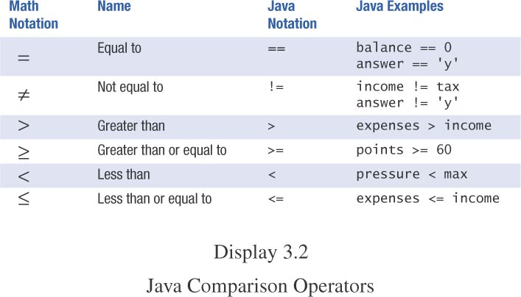
Java Comparison Operators
10-08-2023
Dr.R.Kayalvizhi, Assistant Professor / NWC

Slide 49
Compound Boolean Expressions
Boolean expressions can be combined using the “and” (&&) operator.
example
if ((score > 0) && (score <= 100))
...
not allowed
if (0 < score <= 100)
...
10-08-2023
Dr.R.Kayalvizhi, Assistant Professor / NWC

Slide 50
Compound Boolean Expressions, cont.
syntax
(Sub_Expression_1) && (Sub_Expression_2)
Parentheses often are used to enhance readability.
The larger expression is true only when both of the smaller expressions are true.
10-08-2023
Dr.R.Kayalvizhi, Assistant Professor / NWC

Slide 51
Compound Boolean Expressions, cont.
Boolean expressions can be combined using the “or” (||) operator.
Example
if ((quantity > 5) || (cost < 10))
...
syntax
(Sub_Expression_1) || (Sub_Expression_2)
10-08-2023
Dr.R.Kayalvizhi, Assistant Professor / NWC

Slide 52
Compound Boolean Expressions, cont.
The larger expression is true
when either of the smaller expressions is true
when both of the smaller expressions are true.
“or” in Java is inclusive or
either or both to be true.
exclusive or
one or the other, but not both to be true.
10-08-2023
Dr.R.Kayalvizhi, Assistant Professor / NWC

Slide 53
Negating a Boolean Expression
Boolean negation
“not” (!) operator.
syntax
!Boolean_Expression
Example:
Boolean walk = false;
System.out.println(!walk);
10-08-2023
Dr.R.Kayalvizhi, Assistant Professor / NWC

Slide 54
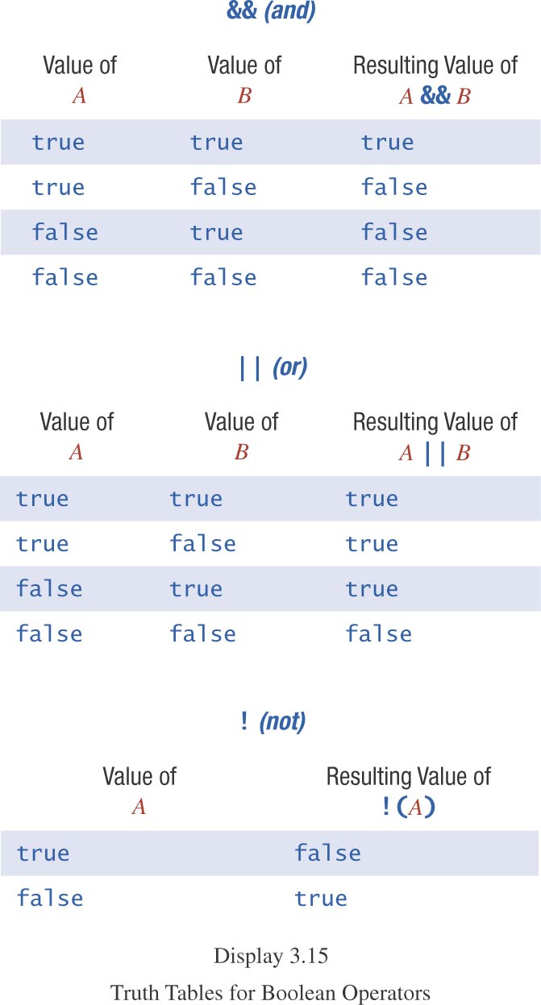
Truth Tables
10-08-2023
Dr.R.Kayalvizhi, Assistant Professor / NWC

Slide 55
Primary Logical Operators
Primary logical operators: and, or, not
Any logical expression can be composed
Example: exclusive or
(a || b) && !(a && b)
Either work or play:
(work || play) && !(work && play)
^ is exclusive-or in Java
work ^ play
not a logical operator in most languages
10-08-2023
Dr.R.Kayalvizhi, Assistant Professor / NWC

Slide 56
Using ==
== is appropriate for determining if two integers or characters have the same value.
if (a == 3)
where a is an integer type
== is not appropriate for determining if two floating point values are equal.
Use < and some appropriate tolerance instead.
if (Math.abs(b - c) < epsilon)
b, c, and epsilon are of floating point type
[www.cs.fit.edu/~pkc/classes/cse1001/FloatEquality.java]
10-08-2023
Dr.R.Kayalvizhi, Assistant Professor / NWC

Slide 57
Using ==, cont.
== is not appropriate for determining if two objects have the same value.
if (s1 == s2)
determines only if s1 and s2 are at the same memory location.
If s1 and s2 refer to strings with identical sequences of characters, but stored in different memory locations
(s1 == s2) is false.
10-08-2023
Dr.R.Kayalvizhi, Assistant Professor / NWC

Slide 58
Using ==, cont.
To test the equality of objects of class String, use method equals.
s1.equals(s2)
or
s2.equals(s1)
www.cs.fit.edu/~pkc/classes/cse1001/StringEqual.java
To test for equality ignoring case, use method equalsIgnoreCase.
(“Hello”.equalsIgnoreCase(“hello”))
10-08-2023
Dr.R.Kayalvizhi, Assistant Professor / NWC

Slide 59
equals and equals IgnoreCase
syntax
String.equals(Other_String)
String.equalsIgnoreCase(Other_String)
10-08-2023
Dr.R.Kayalvizhi, Assistant Professor / NWC

Slide 60
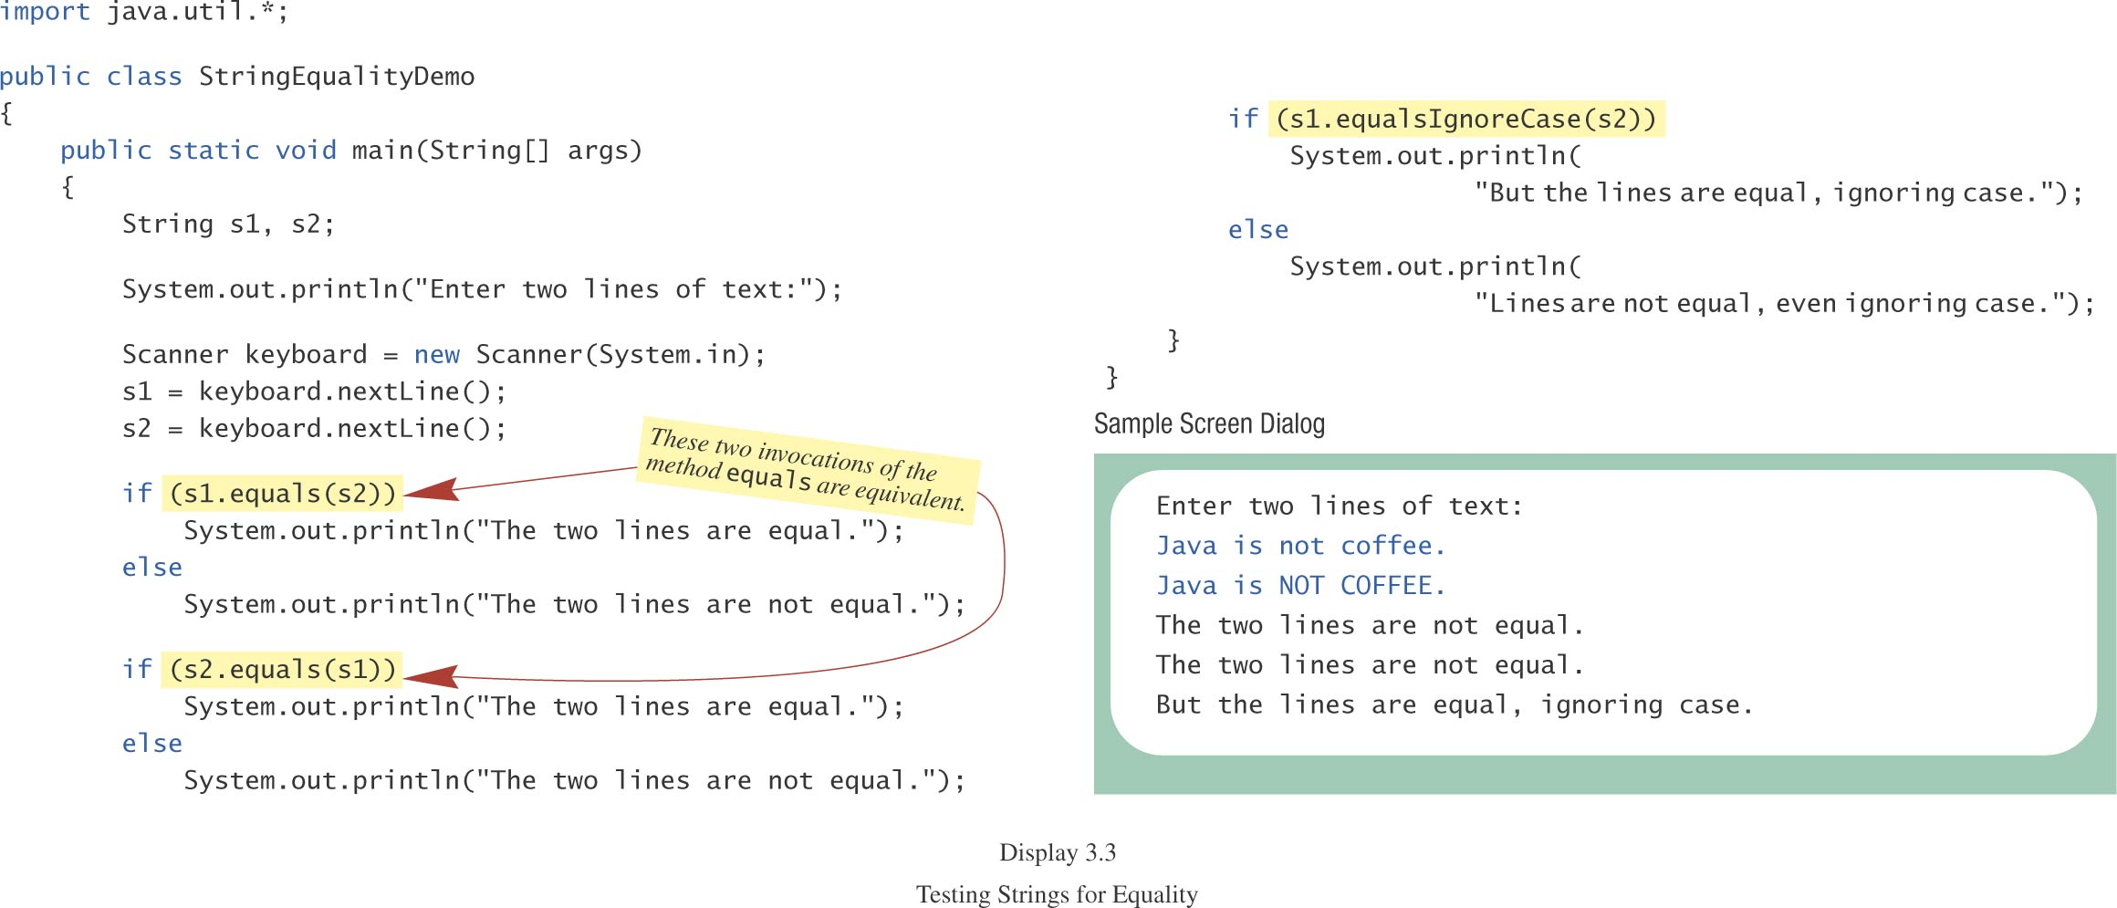
Testing Strings for Equality
class StringEqualityDemo
10-08-2023
Dr.R.Kayalvizhi, Assistant Professor / NWC

Slide 61
Lexicographic Order
Lexicographic order is similar to alphabetical order, but is it based on the order of the characters in the ASCII (and Unicode) character set.
All the digits come before all the letters.
All the uppercase letters come before all the lower case letters.
10-08-2023
Dr.R.Kayalvizhi, Assistant Professor / NWC

Slide 62
Lexicographic Order, cont.
Strings consisting of alphabetical characters can be compared using method compareTo and method toUpperCase or method toLowerCase.
String s1 = “Hello”;
String lowerS1 = s1.toLowerCase();
String s2 = “hello”;
if (lowerS1.compareTo(s2) == 0)
System.out.println(“Equal!”);
//or use s1.compareToIgnoreCase(s2)
10-08-2023
Dr.R.Kayalvizhi, Assistant Professor / NWC

Slide 63
Method compareTo
syntax
String_1.compareTo(String_2)
Method compareTo returns
a negative number if String_1 precedes String_2
zero if the two strings are equal
a positive number of String_2 precedes String_1
Tip: Think of compareTo is subtraction
10-08-2023
Dr.R.Kayalvizhi, Assistant Professor / NWC

Slide 64
Comparing Numbers vs. Comparing Strings
Integer and floating-point values | String objects
== != | equals( ) equalsIgnoreCase( )
> < >= <= | compareTo( ) [lexicographical ordering]
10-08-2023
Dr.R.Kayalvizhi, Assistant Professor / NWC

Slide 65
Short-Circuit Evaluation
Java evaluates the && and || operators using a strategy called short-circuit mode in which it evaluates the right operand only if it needs to do so.
For example, if n is 0, the right hand operand of && in
n != 0 && x % n == 0
is not evaluated at all because n != 0 is false. Because the expression
false && anything
is always false, the rest of the expression no longer matters.
One of the advantages of short-circuit evaluation is that you can use && and || to prevent execution errors. If n were 0 in the earlier example, evaluating x % n would cause a “division by zero” error.
10-08-2023
Dr.R.Kayalvizhi, Assistant Professor / NWC

Slide 66
Designing for Change
While it is clearly necessary for you to write programs that the compiler can understand, good programmers are equally concerned with writing code that people can understand.
The importance of human readability arises from the fact that programs must be maintained over their life cycle.
Typically, as much as 90 percent of the programming effort comes after the initial release of a system.
There are several useful techniques that you can adopt to increase readability:
Use names that clearly express the purpose of variables and methods
Use proper indentation to make the structure of your programs clear
Use named constants to enhance both readability and maintainability
10-08-2023
Dr.R.Kayalvizhi, Assistant Professor / NWC

Slide 67
Precedence and associativity of Java operators.
The table below shows all Java operators from highest to lowest precedence, along with their associativity.
Most programmers do not memorize them all, and even those that do still use parentheses for clarity.
10-08-2023
Dr.R.Kayalvizhi, Assistant Professor / NWC

Slide 68
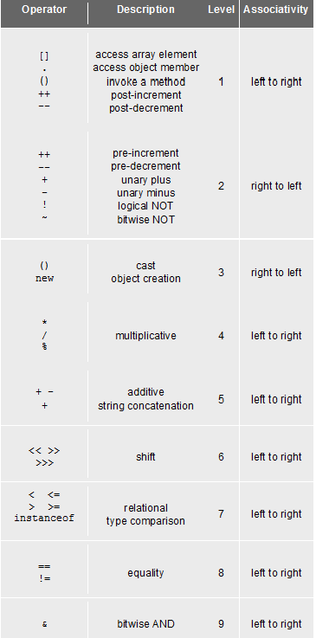
Precedence and associativity of Java operators.
10-08-2023
Dr.R.Kayalvizhi, Assistant Professor / NWC
Operator | Description | Level | Associativity
[] . () ++ -- | access array element access object member invoke a method post-increment post-decrement | 1 | left to right
++ -- + - ! ~ | pre-increment pre-decrement unary plus unary minus logical NOT bitwise NOT | 2 | right to left
() new | cast object creation | 3 | right to left
* / % | multiplicative | 4 | left to right
+ - + | additive string concatenation | 5 | left to right
<< >> >>> | shift | 6 | left to right
< <=> >= instanceof | relational type comparison | 7 | left to right
== != | equality | 8 | left to right
& | bitwise AND | 9 | left to right
^ | bitwise XOR | 10 | left to right
| | bitwise OR | 11 | left to right
&& | conditional AND | 12 | left to right
|| | conditional OR | 13 | left to right
?: | conditional | 14 | right to left
= += -= *= /= %= &= ^= |=<<= >>= >>>= | assignment | 15 | right to left

Slide 69
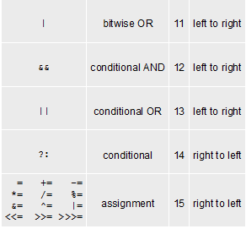
10-08-2023
Dr.R.Kayalvizhi, Assistant Professor / NWC

Slide 70
Flow of Control
Flow of control is the order in which a program performs actions.
Up to this point, the order has been sequential.
A branching statement chooses between two or more possible actions.
A loop statement repeats an action until a stopping condition occurs.
10-08-2023
Dr.R.Kayalvizhi, Assistant Professor / NWC

Slide 71
Branching Statements: Outline
The if-else Statement
Introduction to Boolean Expressions
Nested Statements and Compound Statements
Multibranch if-else Statements
The switch Statament
(optional) The Conditional Operator
10-08-2023
Dr.R.Kayalvizhi, Assistant Professor / NWC

Slide 72
The if-else Statement
A branching statement that chooses between two possible actions.
syntax
if (Boolean_Expression)
Statement_1
else
Statement_2
10-08-2023
Dr.R.Kayalvizhi, Assistant Professor / NWC

Slide 73
The if-else Statement, cont.
Example
if (count < 3)
total = 0;
else
total = total + count;
10-08-2023
Dr.R.Kayalvizhi, Assistant Professor / NWC

Slide 74
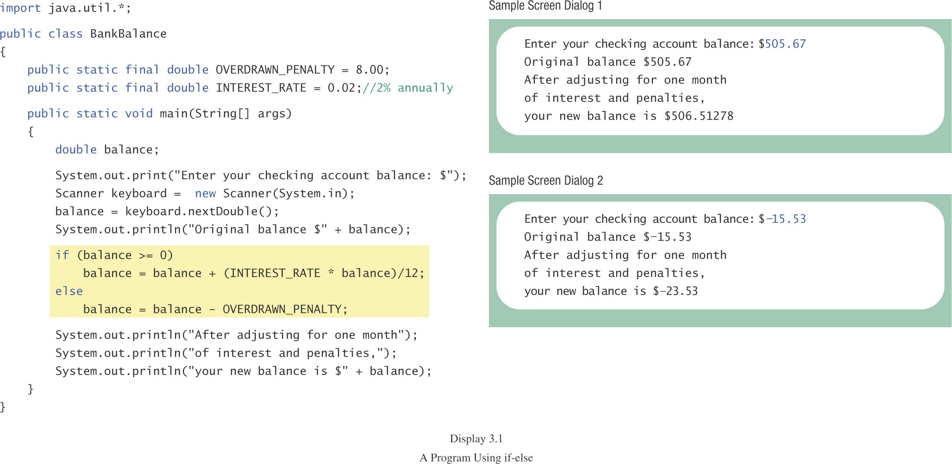
The if-else Statement, cont.
class BankBalance
10-08-2023
Dr.R.Kayalvizhi, Assistant Professor / NWC

Slide 75
Nested Statements
An if-else statement can contain any sort of statement within it.
In particular, it can contain another if-else statement.
An if-else may be nested within the “if” part.
An if-else may be nested within the “else” part.
An if-else may be nested within both parts.
10-08-2023
Dr.R.Kayalvizhi, Assistant Professor / NWC

Slide 76
Nested Statements, cont.
syntax
if (Boolean_Expression_1)
if (Boolean_Expression_2)
Statement_1
else
Statement_2
else
if (Boolean_Expression_3)
Statement_3
else
Statement_4
10-08-2023
Dr.R.Kayalvizhi, Assistant Professor / NWC

Slide 77
Nested if Example
if (temperature > 90) // int temperature
if (sunny) // boolean sunny
System.out.println(“Beach”);
else
System.out.println(“Movie”);
else
if (sunny)
System.out.println(“Tennis”);
else
System.out.println(“Volleyball”);
10-08-2023
Dr.R.Kayalvizhi, Assistant Professor / NWC

Slide 78
Nested Statements, cont.
Each else is paired with the nearest unmatched if.
Indentation can communicate which if goes with which else.
Braces are used to group statements.
10-08-2023
Dr.R.Kayalvizhi, Assistant Professor / NWC

Slide 79
Nested Statements, cont.
Different indentation
first form second form
if (a > b) if (a > b)
if (c > d) if (c > d)
e = f; e = f;
else else
g = h; g = h;
Same to the compiler!
10-08-2023
Dr.R.Kayalvizhi, Assistant Professor / NWC

Slide 80
Nested Statements, cont.
Are these different?
first form second form
if (a > b) if (a > b)
{ if (c > d)
if (c > d) e = f;
e = f; else
} g =h;
else
g = h;
10-08-2023
Dr.R.Kayalvizhi, Assistant Professor / NWC

Slide 81
Nested Statements, cont.
Proper indentation and nested if-else statements
“else” with outer “if” “else” with inner “if”
if (a > b) if (a > b)
{ if (c > d)
if (c > d) e = f;
e = f; else
} g =h;
else
g = h;
10-08-2023
Dr.R.Kayalvizhi, Assistant Professor / NWC

Slide 82
Compound Statements
When a list of statements is enclosed in braces ({}), they form a single compound statement.
syntax
{
Statement_1;
Statement_2;
…
}
10-08-2023
Dr.R.Kayalvizhi, Assistant Professor / NWC

Slide 83
Compound Statements, cont.
A compound statement can be used wherever a statement can be used.
example
if (total > 10)
{
sum = sum + total;
total = 0;
}
10-08-2023
Dr.R.Kayalvizhi, Assistant Professor / NWC

Slide 84
Multibranch if-else Statements
syntax
if (Boolean_Expression_1)
Statement_1
else if (Boolean_Expression_2)
Statement_2
else if (Boolean_Expression_3)
Statement_3
else if …
else
Default_Statement
10-08-2023
Dr.R.Kayalvizhi, Assistant Professor / NWC

Slide 85
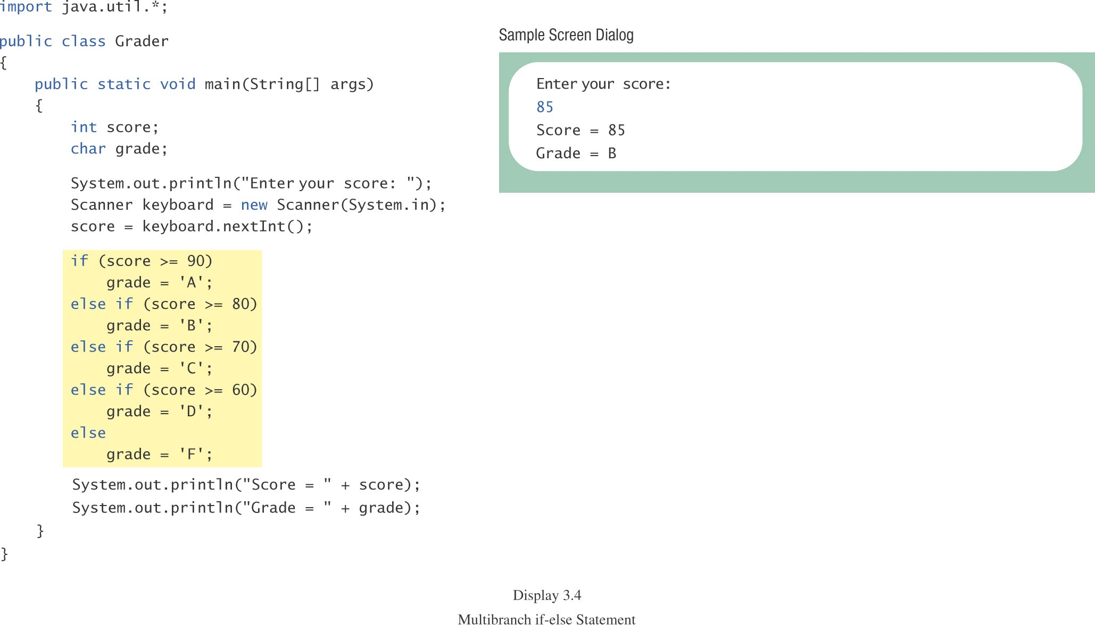
Multibranch if-else Statements, cont.
class Grader
10-08-2023
Dr.R.Kayalvizhi, Assistant Professor / NWC

Slide 86
Multibranch if-else Statements, cont.
equivalent logically
if (score >= 90)
grade = ‘A’;
if ((score >= 80) && (score < 90))
grade = ‘B’;
if ((score >= 70) && (score < 80))
grade = ‘C’;
if ((score >= 60) && (score < 70))
grade = ‘D’;
if (score < 60)
grade = ‘F’;
10-08-2023
Dr.R.Kayalvizhi, Assistant Professor / NWC

Slide 87
switch Statement
The switch statement is a multiway branch that makes a decision based on an integral (integer or character) expression.
The switch statement begins with the keyword switch followed by an integral expression in parentheses and called the controlling expression.
10-08-2023
Dr.R.Kayalvizhi, Assistant Professor / NWC

Slide 88
switch Statement, cont.
A list of cases follows, enclosed in braces.
Each case consists of the keyword case followed by
a constant called the case label
a colon
a list of statements.
The list is searched for a case label matching the controlling expression.
10-08-2023
Dr.R.Kayalvizhi, Assistant Professor / NWC

Slide 89
switch Statement, cont.
The action associated with a matching case label is executed.
If no match is found, the case labeled default is executed.
The default case is optional, but recommended, even if it simply prints a message.
Repeated case labels are not allowed.
10-08-2023
Dr.R.Kayalvizhi, Assistant Professor / NWC

Slide 90
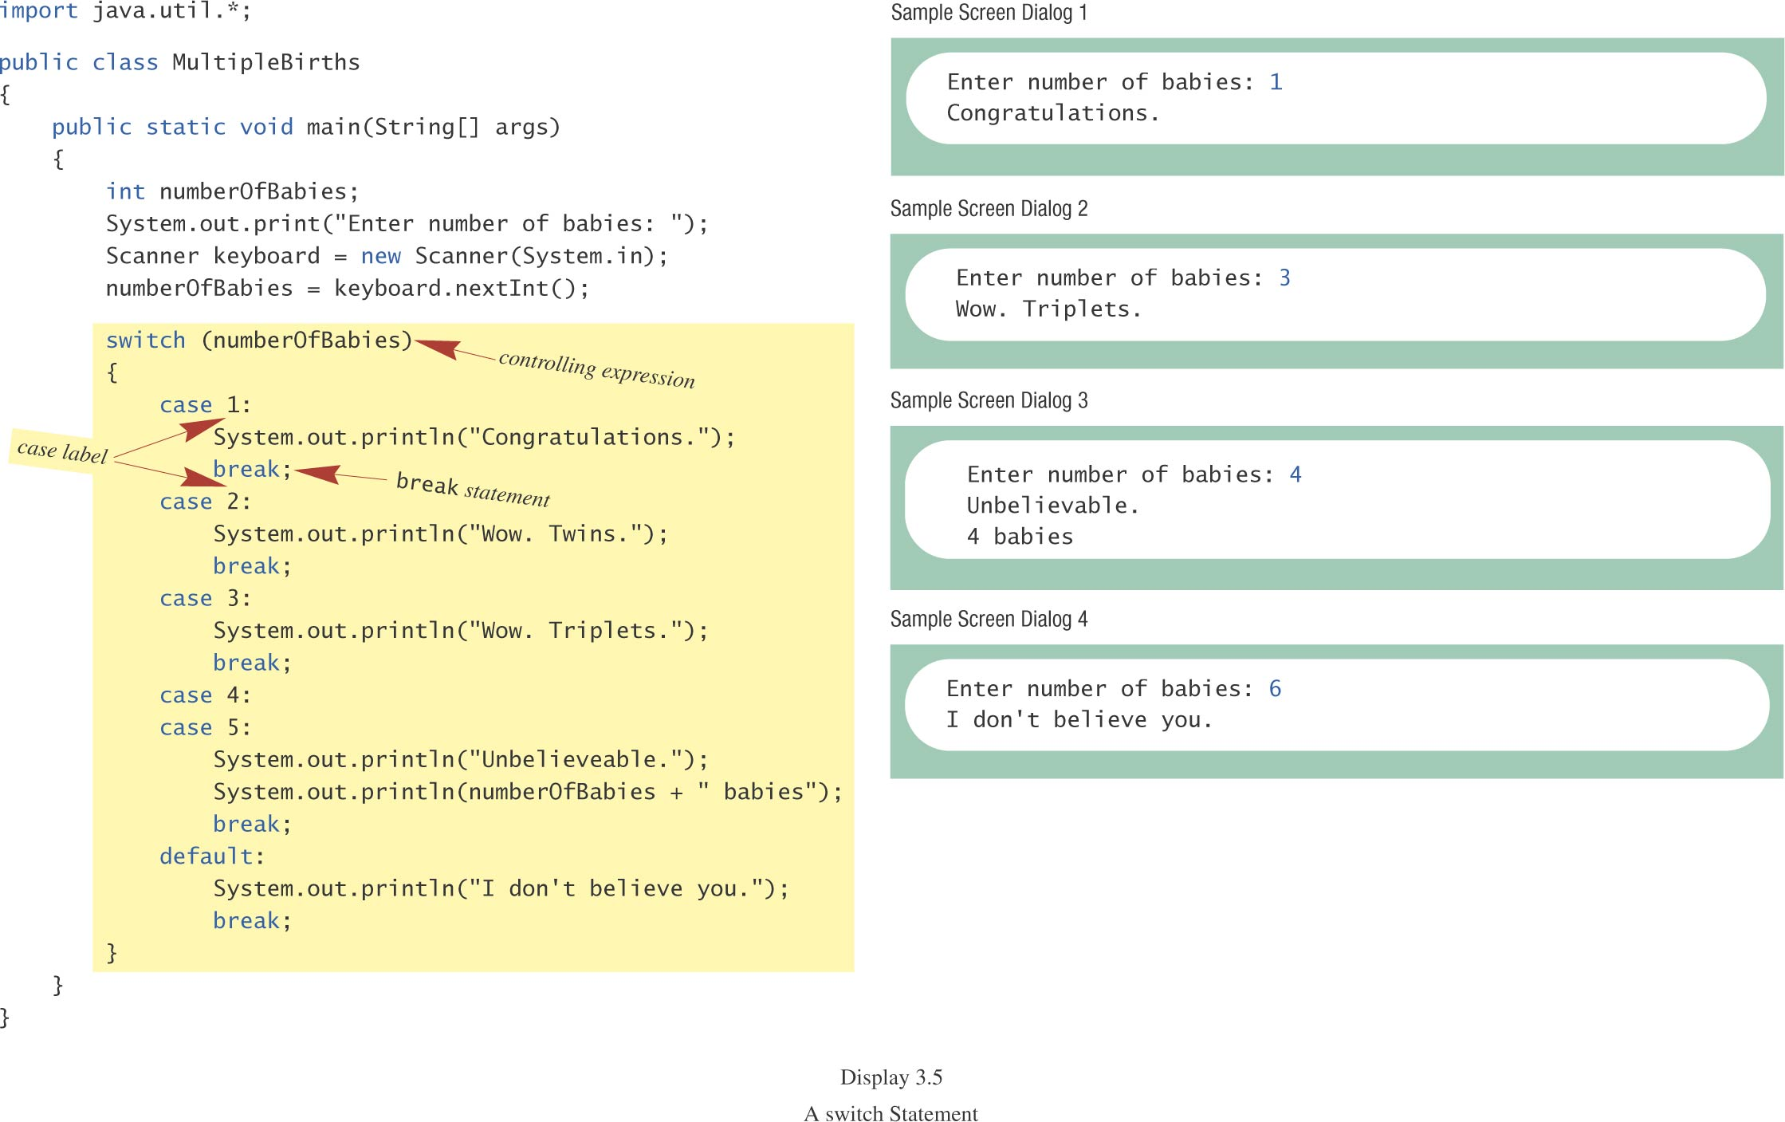
switch Statement, cont.
class MultipleBirths
10-08-2023
Dr.R.Kayalvizhi, Assistant Professor / NWC

Slide 91
switch Statement, cont.
The action for each case typically ends with the word break.
The optional break statement prevents the consideration of other cases.
The controlling expression can be anything that evaluates to an integral type (integer or character).
10-08-2023
Dr.R.Kayalvizhi, Assistant Professor / NWC

Slide 92
The switch Statement, cont.
syntax
switch (Controlling_Expression)
{
case Case_Label:
Statement(s);
break;
case Case_Label:
…
default:
…
}
10-08-2023
Dr.R.Kayalvizhi, Assistant Professor / NWC

Slide 93
Switch with char Type
char grade = 'A';
switch(grade)
{
case 'A':
case 'B':
case 'C':
case 'D':
System.out.println("Pass");
break;
case 'W':
System.out.println("Withdraw");
break;
case 'I':
System.out.println("Incomplete");
break;
default:
System.out.println("Fail");
}
10-08-2023
Dr.R.Kayalvizhi, Assistant Professor / NWC

Slide 94
Conditional Operator
if (n1 > n2)
max = n1;
else
max = n2;
can be written as
max = (n1 > n2) ? n1 : n2;
The ? and : together is called the conditional operator (a ternary operator).
Note (n1 > n2) ? n1 : n2 is an expression that has a value unlike the “normal” if statement
10-08-2023
Dr.R.Kayalvizhi, Assistant Professor / NWC

Slide 95
Conditional Operator, cont.
The conditional operator can be useful with print statements.
System.out.print(“You worked “ + hours + “ “ +
((hours > 1) ? “hours” : “hour”));
10-08-2023
Dr.R.Kayalvizhi, Assistant Professor / NWC

Slide 96
Summary of branching
if statement (1 or 2 branches)
Multi-branch if-else-if statement (3 or more branches)
Multi-branch switch statement
Conditional operator ? :
10-08-2023
Dr.R.Kayalvizhi, Assistant Professor / NWC

Slide 97
Loop Statements
A portion of a program that repeats a statement or a group of statements is called a loop.
The statement or group of statements to be repeated is called the body of the loop.
A loop could be used to compute grades for each student in a class.
There must be a means of exiting the loop.
10-08-2023
Dr.R.Kayalvizhi, Assistant Professor / NWC

Slide 98
Loop Structure
Control of loop: ICU
Initialization
Condition for termination (continuing)
Updating the condition
Body of loop
10-08-2023
Dr.R.Kayalvizhi, Assistant Professor / NWC

Slide 99
Loop Statements
the while Statement
the do-while Statement
the for Statement
10-08-2023
Dr.R.Kayalvizhi, Assistant Professor / NWC

Slide 100
while Statement
also called a while loop
a controlling boolean expression
True -> repeats the statements in the loop body
False -> stops the loop
Initially false (the very first time)
loop body will not even execute once
10-08-2023
Dr.R.Kayalvizhi, Assistant Professor / NWC

Slide 101
while Statement, cont.
syntax
while (Boolean_Expression)
Body_Statement
or
while (Boolean_Expression)
{
First_Statement
Second_Statement
…
}
10-08-2023
Dr.R.Kayalvizhi, Assistant Professor / NWC

Slide 102
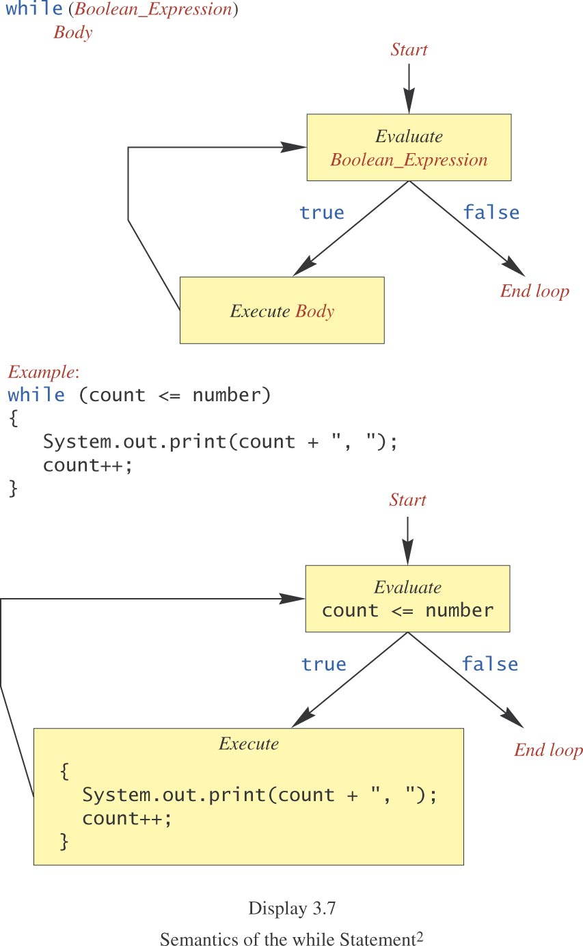
while Statement, cont.
10-08-2023
Dr.R.Kayalvizhi, Assistant Professor / NWC

Slide 103
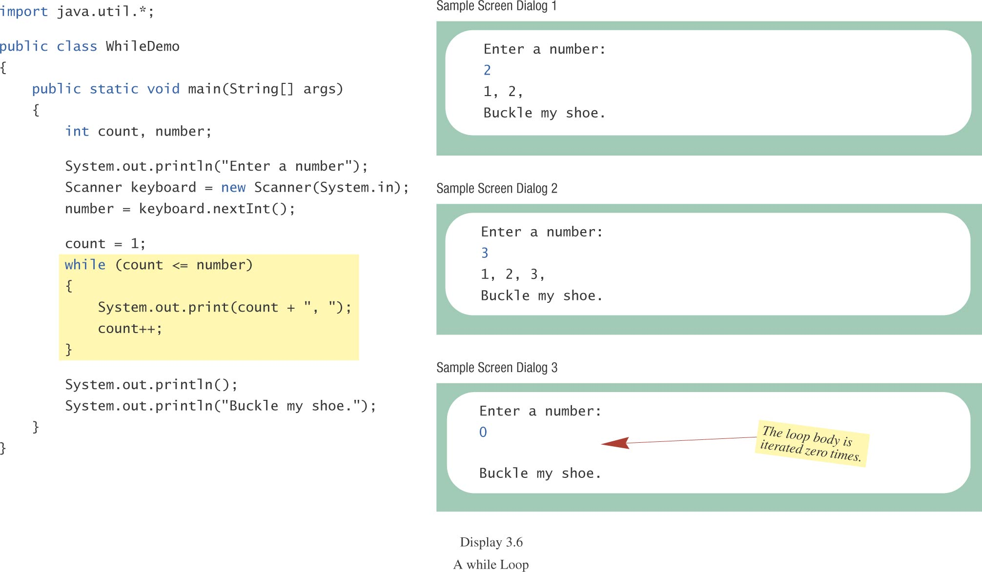
while Statement, cont.
class WhileDemo
10-08-2023
Dr.R.Kayalvizhi, Assistant Professor / NWC

Slide 104
do-while Statement
also called a do-while loop (repeat-until loop)
similar to a while statement
except that the loop body is executed at least once
syntax
do
Body_Statement
while (Boolean_Expression);
don’t forget the semicolon at the end!
10-08-2023
Dr.R.Kayalvizhi, Assistant Professor / NWC

Slide 105
do-while Statement, cont.
First, the loop body is executed.
Then the boolean expression is checked.
As long as it is true, the loop is executed again.
If it is false, the loop exits.
equivalent while statement
Statement(s)_S1
while (Boolean_Condition)
Statement(s)_S1
10-08-2023
Dr.R.Kayalvizhi, Assistant Professor / NWC

Slide 106
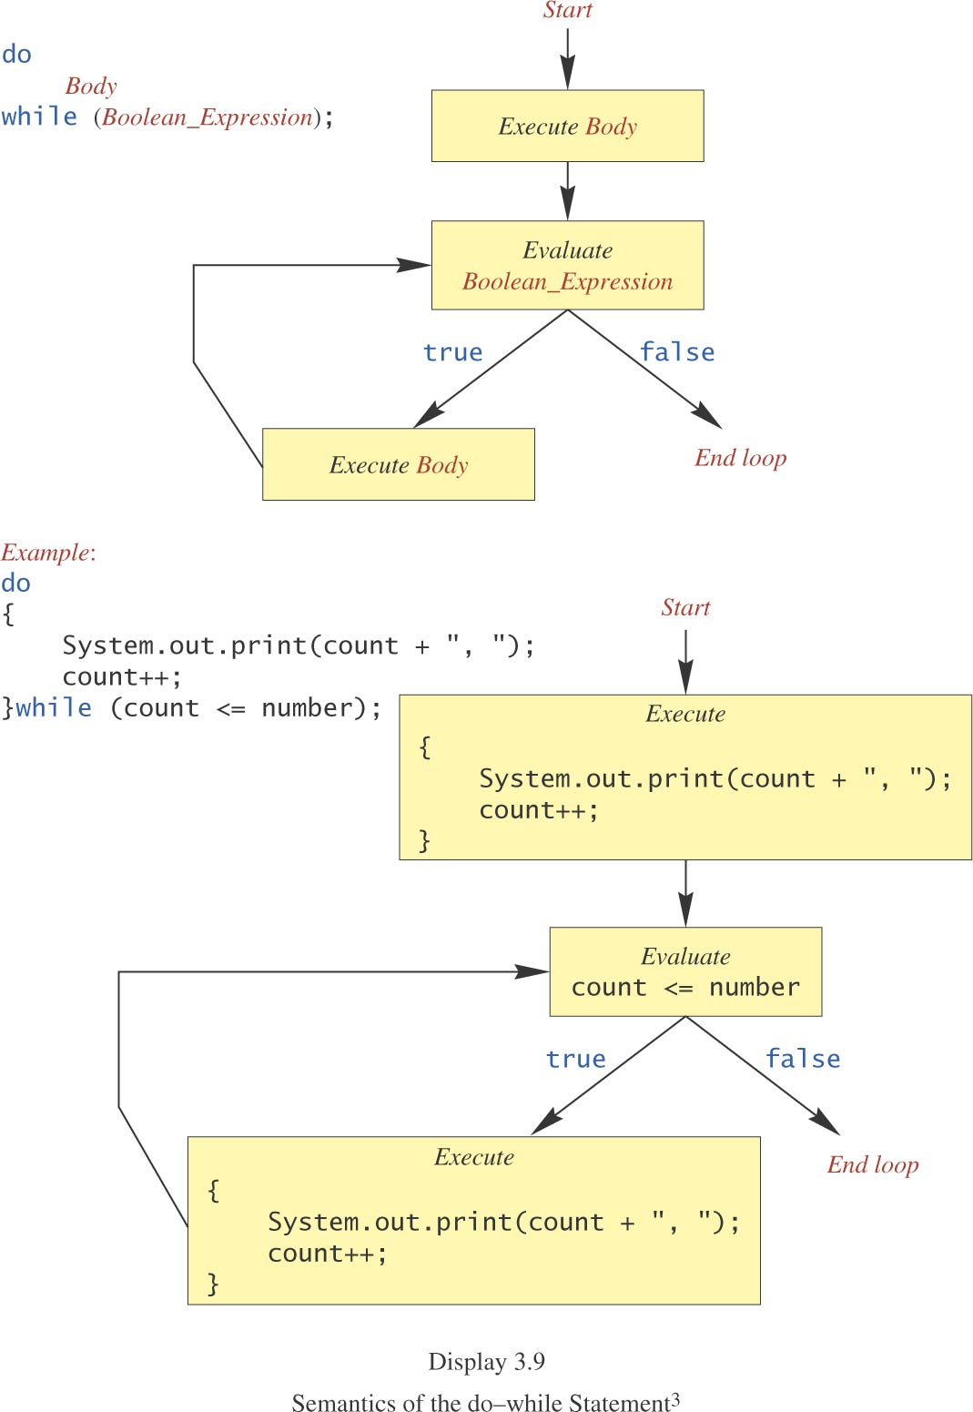
do-while Statement, cont.
10-08-2023
Dr.R.Kayalvizhi, Assistant Professor / NWC

Slide 107
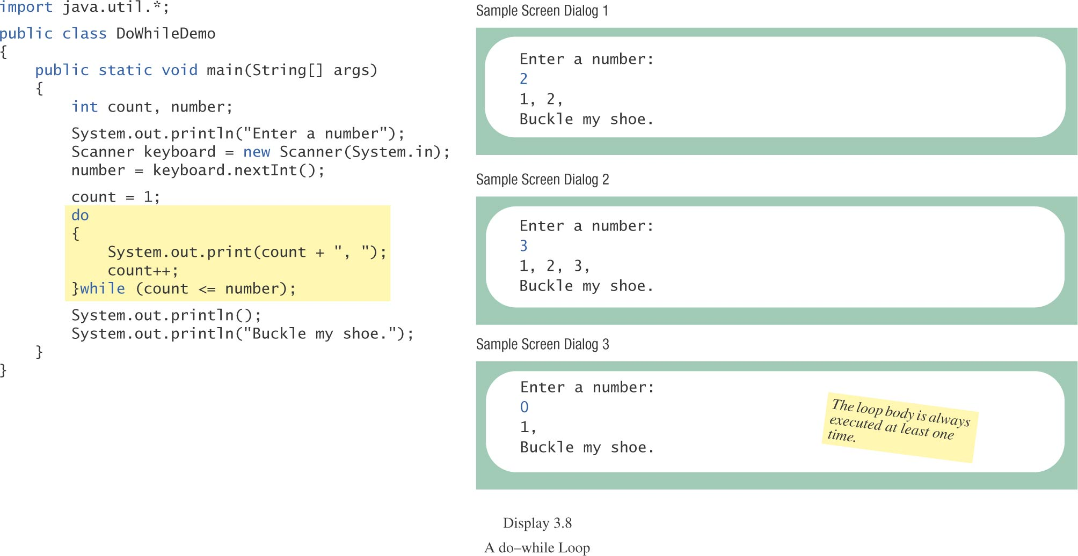
do-while Statement, cont.
class DoWhileDemo
10-08-2023
Dr.R.Kayalvizhi, Assistant Professor / NWC

Slide 108
Programming Example: Bug Infestation
given
volume of a roach: 0.0002 cubic feet
starting roach population
rate of increase: 95%/week
volume of a house
find
number of weeks to exceed the capacity of the house
number and volume of roaches
10-08-2023
Dr.R.Kayalvizhi, Assistant Professor / NWC

Slide 109
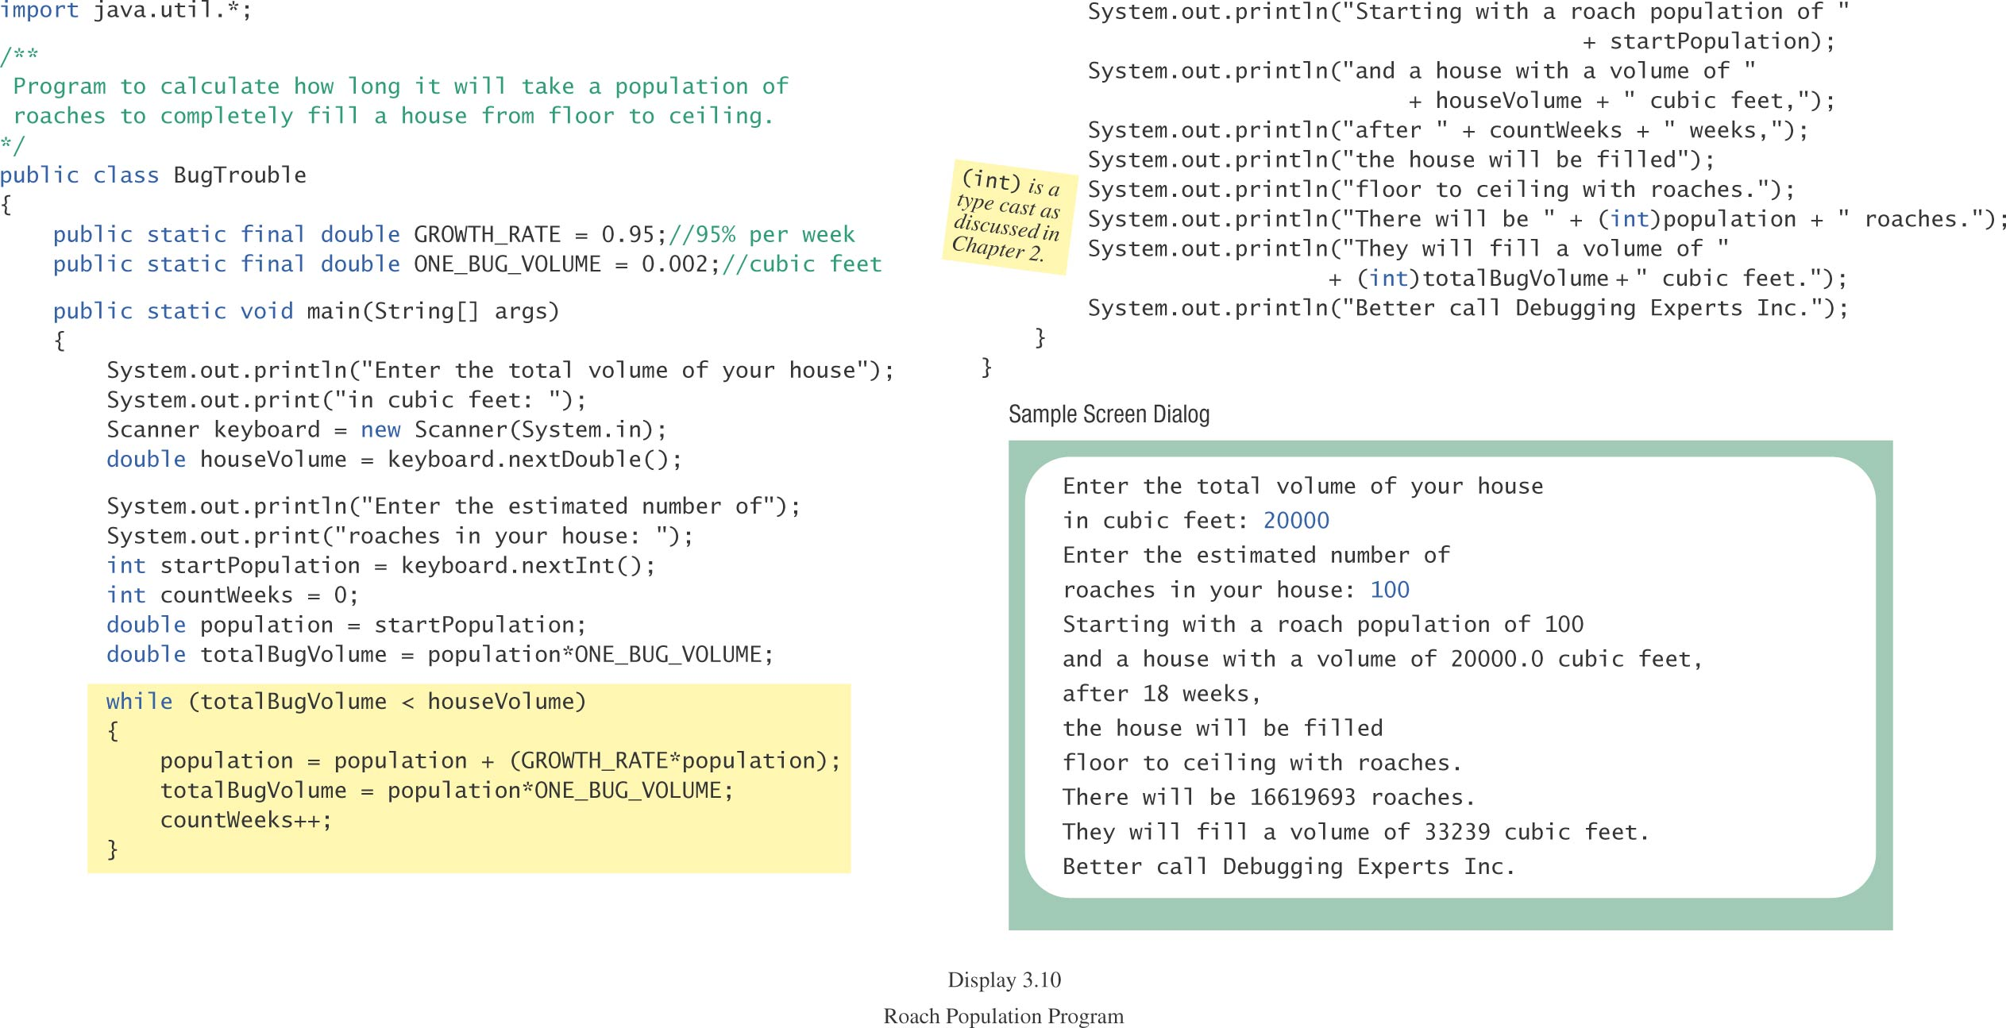
Programming Example: Bug Infestation, cont.
class BugTrouble
10-08-2023
Dr.R.Kayalvizhi, Assistant Professor / NWC

Slide 110
Infinite Loops
A loop which repeats without ever ending
the controlling boolean expression (condition to continue)
never becomes false
A negative growth rate in the preceding problem causes totalBugVolume always to be less than houseVolume
the loop never ends.
10-08-2023
Dr.R.Kayalvizhi, Assistant Professor / NWC

Slide 111
for Statement
A for statement executes the body of a loop a fixed number of times.
example
for (count = 1; count < 3; count++)
System.out.println(count);
System.out.println(“Done”);
10-08-2023
Dr.R.Kayalvizhi, Assistant Professor / NWC

Slide 112
for Statement, cont.
syntax
for (Initialization; Condition; Update)
Body_Statement
Body_Statement
a simple statement or
a compound statement in {}.
corresponding while statement
Initialization
while (Condition)
Body_Statement_Including_Update
10-08-2023
Dr.R.Kayalvizhi, Assistant Professor / NWC

Slide 113
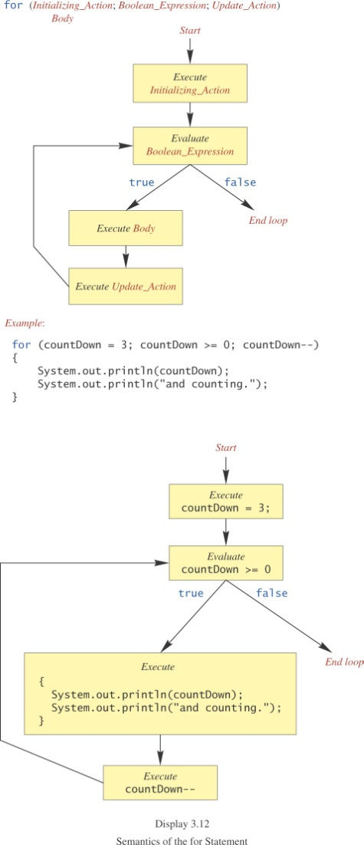
for Statement, cont.
10-08-2023
Dr.R.Kayalvizhi, Assistant Professor / NWC

Slide 114
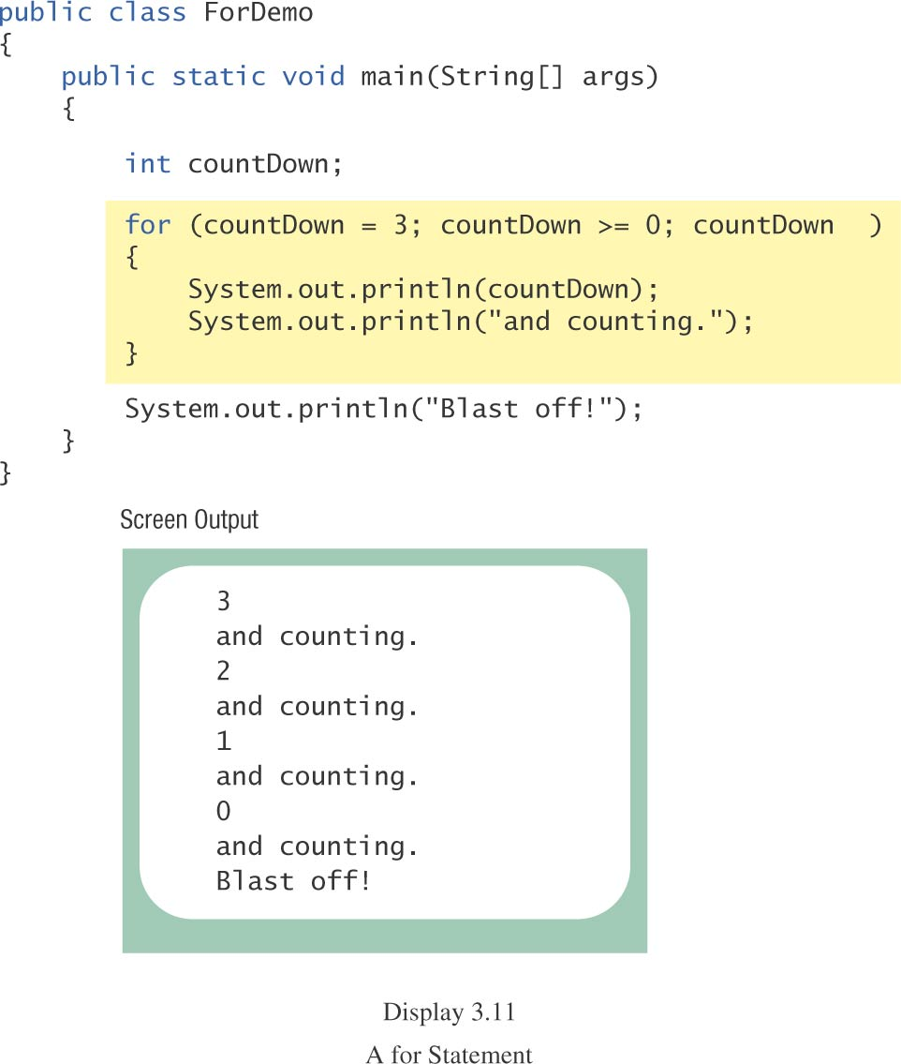
for Statement, cont.
class ForDemo
10-08-2023
Dr.R.Kayalvizhi, Assistant Professor / NWC

Slide 115
Multiple Initialization, etc.
example
for (n = 1, p = 1; n < 10; n++)
p = p * n
Only one boolean expression is allowed, but it can consist of &&s, ||s, and !s.
Multiple update actions are allowed, too.
for (n = 1, p = 100; n < p; n++, p -= n)
rarely used
10-08-2023
Dr.R.Kayalvizhi, Assistant Professor / NWC

Slide 116
Choosing a Loop Statement
If you know how many times the loop will be iterated, use a for loop.
If you don’t know how many times the loop will be iterated, but
it could be zero, use a while loop
it will be at least once, use a do-while loop.
Generally, a while loop is a safe choice.
10-08-2023
Dr.R.Kayalvizhi, Assistant Professor / NWC

Slide 117
Summary of loop statements
while loop
do-while loop
for loop
10-08-2023
Dr.R.Kayalvizhi, Assistant Professor / NWC

Slide 118
break Statement in Loops: NOT recommended
A break statement can be used to end a loop immediately.
The break statement ends only the innermost loop that contains the break statement.
break statements make loops more difficult to understand:
Loop could end at different places (multiple possible exit points), harder to know where.
Always try to end a loop at only one place--makes debugging easier (only one possible exit point)
10-08-2023
Dr.R.Kayalvizhi, Assistant Professor / NWC

Slide 119
Misuse of break Statements in loops
“Because of the complications they introduce, break statements in loops should be avoided.
Some authorities contend that a break statement should never be used to end a loop,
but virtually all programming authorities agree that they should be used at most sparingly.”
10-08-2023
Dr.R.Kayalvizhi, Assistant Professor / NWC

Slide 120
exit Method
Sometimes a situation arises that makes continuing the program pointless.
A program can be terminated normally by
System.exit(0).
example
if (numberOfWinners == 0)
{
System.out.println(“/ by 0”);
System.exit(0);
}
10-08-2023
Dr.R.Kayalvizhi, Assistant Professor / NWC

Slide 121
Arrays in JAVA

Slide 122
Declaring an Array Variable
Do not have to create an array while declaring array variable
<data type> [] variable_name;
int [] prime;
int prime[];
Both syntaxes are equivalent
No memory allocation at this point
10-08-2023
Dr.R.Kayalvizhi, Assistant Professor / NWC

Slide 123
Defining an Array
Define an array as follows:
variable_name=new <data type>[N];
primes=new int[10];
Declaring and defining in the same statement:
int[] primes=new int[10];
In JAVA, int is of 4 bytes, total space=4*10=40 bytes
10-08-2023
Dr.R.Kayalvizhi, Assistant Professor / NWC

Slide 124
Graphical Representation
Index
prime
0 | 1 | 2 | 3 | 4 | 5 | 6 | 7 | 8 | 9
2 | 1 | 11 | -9 | 2 | 1 | 11 | 90 | 101 | 2
value
10-08-2023
Dr.R.Kayalvizhi, Assistant Professor / NWC

Slide 125
What happens if …
We define
int[] prime=new long[20];
MorePrimes.java:5: incompatible types
found: long[]
required: int[]
int[] primes = new long[20];
^
The right hand side defines an array, and thus the array variable should refer to the same type of array
10-08-2023
Dr.R.Kayalvizhi, Assistant Professor / NWC

Slide 126
Array Size through Input
BufferedReader stdin = new BufferedReader (new InputStreamReader(System.in));
String inData;
int num;
System.out.println("Enter a Size for Array:");
inData = stdin.readLine();
num = Integer.parseInt( inData ); // convert inData to int
long[] primes = new long[num];
System.out.println(“Array Length=”+primes.length);
….
SAMPLE RUN:
Enter a Size for Array:
4
Array Length=4
10-08-2023
Dr.R.Kayalvizhi, Assistant Professor / NWC

Slide 127
Default Initialization
When array is created, array elements are initialized
Numeric values (int, double, etc.) to 0
Boolean values to false
Class types to null
10-08-2023
Dr.R.Kayalvizhi, Assistant Professor / NWC

Slide 128
Accessing Array Elements
Index of an array is defined as
Positive int, byte or short values
Expression that results into these types
Any other types used for index will give error
long, double, etc.
Incase Expression results in long, then type cast to int
Indexing starts from 0 and ends at N-1
primes[2]=0;
int k = primes[2];
…
10-08-2023
Dr.R.Kayalvizhi, Assistant Professor / NWC

Slide 129
Validating Indexes
JAVA checks whether the index values are valid at runtime
If index is negative or greater than the size of the array then an IndexOutOfBoundException will be thrown
Program will normally be terminated unless handled in the try {} catch {}
10-08-2023
Dr.R.Kayalvizhi, Assistant Professor / NWC

Slide 130
What happens if …
long[] primes = new long[20];
primes[25]=33;
….
Runtime Error:
Exception in thread “main” java.lang.ArrayIndexOutOfBoundsException: 25
at MorePrimes.main(MorePrimes.java:6)
10-08-2023
Dr.R.Kayalvizhi, Assistant Professor / NWC

Slide 131
Reusing Array Variables
Array variable is separate from array itself
Like a variable can refer to different values at different points in the program
Use array variables to access different arrays
int[] primes=new int[10];
……
primes=new int[50];
Previous array will be discarded
Cannot alter the type of array
10-08-2023
Dr.R.Kayalvizhi, Assistant Professor / NWC

Slide 132
Demonstration
long[] primes = new long[20];
primes[0] = 2;
primes[1] = 3;
long[] primes2=primes;
System.out.println(primes2[0]);
primes2[0]=5;
System.out.println(primes[0]);
10-08-2023
Dr.R.Kayalvizhi, Assistant Professor / NWC

Slide 133
Output
2
5
10-08-2023
Dr.R.Kayalvizhi, Assistant Professor / NWC

Slide 134
Array Length
Refer to array length using length
A data member of array object
array_variable_name.length
for(int k=0; k<primes.length;k++)
….
Sample Code:
long[] primes = new long[20];
System.out.println(primes.length);
Output: 20
10-08-2023
Dr.R.Kayalvizhi, Assistant Professor / NWC

Slide 135
Sample Program
*Program taken from: http://chortle.ccsu.edu/CS151/Notes/chap47/ch47_10.html
class MinAlgorithm
{
public static void main ( String[] args )
{
int[] array = { -20, 19, 1, 5, -1, 27, 19, 5 } ;
int min=array[0]; // initialize the current minimum
for ( int index=0; index < array.length; index++ )
if ( array[ index ] < min )
min = array[ index ] ;
System.out.println("The minimum of this array is: " + min );
}
}
10-08-2023
Dr.R.Kayalvizhi, Assistant Professor / NWC

Slide 136
Arrays of Arrays
Two-Dimensional arrays
float[][] temperature=new float[10][365];
10 arrays each having 365 elements
First index: specifies array (row)
Second Index: specifies element in that array (column)
In JAVA float is 4 bytes, total Size=4*10*365=14,600 bytes
10-08-2023
Dr.R.Kayalvizhi, Assistant Professor / NWC

Slide 137
Initializing Array of Arrays
int[][] array2D = { {99, 42, 74, 83, 100}, {90, 91, 72, 88, 95}, {88, 61, 74, 89, 96}, {61, 89, 82, 98, 93}, {93, 73, 75, 78, 99}, {50, 65, 92, 87, 94}, {43, 98, 78, 56, 99} };
//5 arrays with 5 elements each
10-08-2023
Dr.R.Kayalvizhi, Assistant Professor / NWC

Slide 138
Initializing Varying Size Arrays
int[][] uneven = { { 1, 9, 4 }, { 0, 2}, { 0, 1, 2, 3, 4 } };
//Three arrays
//First array has 3 elements
//Second array has 2 elements
//Third array has 5 elements
10-08-2023
Dr.R.Kayalvizhi, Assistant Professor / NWC

Slide 139
Inheritance
Inheritance is one of the cornerstones of object-oriented programming because it allows the creation of hierarchical classifications.
In the terminology of Java, a class that is inherited is called a superclass.
The class that does the inheriting is called a subclass. Therefore, a subclass is a specialized version of a superclass.
It inherits all of the members defined by the superclass and adds its own, unique elements.
10-08-2023
Dr.R.Kayalvizhi, Assistant Professor / NWC

Slide 140
Inheritance Basics
To inherit a class, you simply incorporate the definition of one class into another by using the extends keyword. To see how, let’s begin with a short example.
The following program creates a superclass called A and a subclass called B.
Notice how the keyword extends is used to create a subclass of A.
10-08-2023
Dr.R.Kayalvizhi, Assistant Professor / NWC

Slide 141
// A simple example of inheritance
class SimpleInheritance {
public static void main(String args []) {
A superOb = new A();
B subOb = new B();
/ The superclass may be used by itself.
superOb.i = 10;
superOb.j = 20;
System.out.println("Contents of superOb: ");
superOb.showij();
System.out.println();
/* The subclass has access to all public members of
its superclass. */
subOb.i = 7;
subOb.j = 8;
subOb.k = 9;
System.out.println("Contents of subOb: ");
subOb.showij();
subOb.showk();
System.out.println();
System.out.println("Sum of i, j and k in subOb:");
subOb.sum();
}
}
// Create a superclass.
class A {
int i, j;
void showij() {
System.out.println("i and j: " + i + " " + j);
}
}
// Create a subclass by extending class A.
class B extends A {
int k;
void showk() {
System.out.println("k: " + k);
}
void sum() {
System.out.println("i+j+k: " + (i+j+k));
}
}
10-08-2023
Dr.R.Kayalvizhi, Assistant Professor / NWC

Slide 142
OUTPUT
The output from this program is shown here:
Contents of superOb:
i and j: 10 20
Contents of subOb:
i and j: 7 8
k: 9
Sum of i, j and k in subOb:
i+j+k: 24
As you can see, the subclass B includes all of the members of its superclass, A. This is
why subOb can access i and j and call showij( ). Also, inside sum( ), i and j can be referred
to directly, as if they were part of B.
Even though A is a superclass for B, it is also a completely independent, stand-alone
class. Being a superclass for a subclass does not mean that the superclass cannot be used
by itself. Further, a subclass can be a superclass for another subclass.
SYNTAX:
The general form of a class declaration that inherits a superclass is shown here:
class subclass-name extends superclass-name
{
// body of class
}
10-08-2023
Dr.R.Kayalvizhi, Assistant Professor / NWC

Slide 143
Member Access and Inheritance
Although a subclass includes all of the members of its superclass, it cannot access those members of the superclass that have been declared as private. For example, consider the following simple class hierarchy:
In a class hierarchy, private members remain private to their class.
This program will not compile because the use of j inside the sum( ) method of B causes an access violation. Since j is declared as private, it is only accessible by other members of its own class. Subclasses have no access to it.
10-08-2023
Dr.R.Kayalvizhi, Assistant Professor / NWC

Slide 144
EXAMPLE
// Create a superclass.
class A {
int i; // public by default
private int j; // private to A
void setij(int x, int y) {
i = x;
j = y;
}
}
// A's j is not accessible here.
class B extends A {
int total;
void sum() {
total = i + j; // ERROR, j is not accessible here
}
}
class Access
{
public static void main(String args[])
{
B subOb = new B();
subOb.setij(10, 12);
subOb.sum();
System.out.println("Total is " + subOb.total);
}
}
10-08-2023
Dr.R.Kayalvizhi, Assistant Professor / NWC

Slide 145
A Superclass Variable Can Reference a Subclass Object
A reference variable of a superclass can be assigned a reference to any subclass derived from that superclass.
class RefDemo
{
public static void main(String args[]) {
BoxWeight weightbox = new BoxWeight(3, 5, 7, 8.37);
Box plainbox = new Box();
double vol;
vol = weightbox.volume();
System.out.println("Volume of weightbox is " + vol);
System.out.println("Weight of weightbox is " +
weightbox.weight);
System.out.println();
// assign BoxWeight reference to Box reference
plainbox = weightbox;
vol = plainbox.volume(); // OK, volume() defined in Box
System.out.println("Volume of plainbox is " + vol);
/* The following statement is invalid because plainbox
does not define a weight member. */
// System.out.println("Weight of plainbox is " + plainbox.weight);
}
}
10-08-2023
Dr.R.Kayalvizhi, Assistant Professor / NWC

Slide 146
A Superclass Variable Can Reference a Subclass Object
weightbox is a reference to BoxWeight objects, and plainbox is a reference to Box objects.
Since BoxWeight is a subclass of Box, it is permissible to assign plainbox a reference to the weightbox object.
It is important to understand that it is the type of the reference variable—not the type of the object that it refers to—that determines what members can be accessed.
That is, when a reference to a subclass object is assigned to a superclass reference variable, you will have access only to those parts of the object defined by the superclass.
This is why plainbox can’t access weight even when it refers to a BoxWeight object. If you think about it, this makes sense, because the superclass has no knowledge of what a subclass adds to it. This is why the last line of code in the preceding fragment is commented out. It is not possible for a Box reference to access the weight field, because Box does not define one.
10-08-2023
Dr.R.Kayalvizhi, Assistant Professor / NWC

Slide 147
USING SUPER
Whenever a subclass needs to refer to its immediate superclass, it can do so by use of the keyword super.
super has two general forms.
The first calls the superclass’ constructor.
The second is used to access a member of the superclass that has been hidden by a member of a subclass.
10-08-2023
Dr.R.Kayalvizhi, Assistant Professor / NWC

Slide 148
Using super to Call Superclass Constructors
A subclass can call a constructor defined by its superclass by use of the following form of
super:
super(arg-list);
Here, arg-list specifies any arguments needed by the constructor in the superclass. super( ) must always be the first statement executed inside a subclass’ constructor.
To see how super( ) is used, consider this improved version of the BoxWeight class:
10-08-2023
Dr.R.Kayalvizhi, Assistant Professor / NWC

Slide 149
SUPER CLASS CONSTRUCTOR
// BoxWeight now uses super to initialize its Box attributes.
class BoxWeight extends Box {
double weight; // weight of box
// initialize width, height, and depth using super()
BoxWeight(double w, double h, double d, double m) {
super(w, h, d); // call superclass constructor
weight = m;
}
}
BoxWeight( ) calls super( ) with the arguments w, h, and d. This causes the Box
constructor to be called, which initializes width, height, and depth using these values.
BoxWeight no longer initializes these values itself. It only needs to initialize the value unique to it: weight. This leaves Box free to make these values private if desired.
10-08-2023
Dr.R.Kayalvizhi, Assistant Professor / NWC

Slide 150
// A complete implementation of BoxWeight.
class Box {
private double width;
private double height;
private double depth;
// construct clone of an object
Box(Box ob) { // pass object to constructor
width = ob.width;
height = ob.height;
depth = ob.depth;
}
// constructor used when all dimensions specified
Box(double w, double h, double d) {
width = w;
height = h;
depth = d;
}
// constructor used when no dimensions specified
Box() {
width = -1; // use -1 to indicate
height = -1; // an uninitialized
depth = -1; // box
}
// constructor used when cube is created
Box(double len) {
width = height = depth = len;
}
// compute and return volume
double volume() {
return width * height * depth;
}
}
class BoxWeight extends Box {
double weight; // weight of box
// construct clone of an object
BoxWeight(BoxWeight ob) { // pass object to constructor
super(ob);
weight = ob.weight;
}
// constructor when all parameters are specified
BoxWeight(double w, double h, double d, double m) {
super(w, h, d); // call superclass constructor
weight = m;
}
// default constructor
BoxWeight() {
super();
weight = -1;
}
// constructor used when cube is created
BoxWeight(double len, double m) {
super(len);
weight = m;
}
}
10-08-2023
Dr.R.Kayalvizhi, Assistant Professor / NWC

Slide 151
class DemoSuper {
public static void main(String args[]) {
BoxWeight mybox1 = new BoxWeight(10, 20, 15, 34.3);
BoxWeight mybox2 = new BoxWeight(2, 3, 4, 0.076);
BoxWeight mybox3 = new BoxWeight(); // default
BoxWeight mycube = new BoxWeight(3, 2);
BoxWeight myclone = new BoxWeight(mybox1);
double vol;
vol = mybox1.volume();
System.out.println("Volume of mybox1 is " + vol);
System.out.println("Weight of mybox1 is " + mybox1.weight);
System.out.println();
vol = mybox2.volume();
System.out.println("Volume of mybox2 is " + vol);
System.out.println("Weight of mybox2 is " + mybox2.weight);
System.out.println();
vol = mybox3.volume();
System.out.println("Volume of mybox3 is " + vol);
System.out.println("Weight of mybox3 is " + mybox3.weight);
System.out.println();
vol = myclone.volume();
System.out.println("Volume of myclone is " + vol);
System.out.println("Weight of myclone is " + myclone.weight);
System.out.println();
vol = mycube.volume();
System.out.println("Volume of mycube is " + vol);
System.out.println("Weight of mycube is " + mycube.weight);
System.out.println();
}
}
This program generates the following output:
Volume of mybox1 is 3000.0
Weight of mybox1 is 34.3
Volume of mybox2 is 24.0
Weight of mybox2 is 0.076
Volume of mybox3 is -1.0
Weight of mybox3 is -1.0
Volume of myclone is 3000.0
Weight of myclone is 34.3
Volume of mycube is 27.0
Weight of mycube is 2.0
Pay special attention to this constructor in BoxWeight:
// construct clone of an object
BoxWeight(BoxWeight ob) { // pass object to constructor
super(ob);
weight = ob.weight;
10-08-2023
Dr.R.Kayalvizhi, Assistant Professor / NWC

Slide 152
SUPER
Notice that super( ) is passed an object of type BoxWeight—not of type Box. This still invokes the constructor Box(Box ob).
As mentioned earlier, a superclass variable can be used to reference any object derived from that class. Thus, we are able to pass a BoxWeight object to the Box constructor. Of course, Box only has knowledge of its own members.
10-08-2023
Dr.R.Kayalvizhi, Assistant Professor / NWC

Slide 153
A Second Use for super
The second form of super acts somewhat like this, except that it always refers to the superclass of the subclass in which it is used.
This usage has the following general form:
super.member
Here, member can be either a method or an instance variable.
This second form of super is most applicable to situations in which member names of a subclass hide members by the same name in the superclass.
Consider this simple class hierarchy:
10-08-2023
Dr.R.Kayalvizhi, Assistant Professor / NWC

Slide 154
// Using super to overcome name hiding.
class A {
int i;
}
// Create a subclass by extending class A.
class B extends A {
int i; // this i hides the i in A
B(int a, int b) {
super.i = a; // i in A
i = b; // i in B
}
10-08-2023
Dr.R.Kayalvizhi, Assistant Professor / NWC

Slide 155
void show() {
System.out.println("i in superclass: " + super.i);
System.out.println("i in subclass: " + i);
}
}
class UseSuper {
public static void main(String args[]) {
B subOb = new B(1, 2);
subOb.show();
}
}
This program displays the following:
i in superclass: 1
i in subclass: 2
Although the instance variable i in B hides the i in A, super allows access to the i
defined in the superclass. As you will see, super can also be used to call methods that are
hidden by a subclass.
10-08-2023
Dr.R.Kayalvizhi, Assistant Professor / NWC

Slide 156
Creating a Multilevel Hierarchy
given three classes called A, B, and C, C can be a subclass of B, Which is a subclass of A. When this type of situation occurs, each subclass inherits all of the traits found in all of its superclasses. In this case, C inherits all aspects of B and A.
10-08-2023
Dr.R.Kayalvizhi, Assistant Professor / NWC

Slide 157
When Constructors Are Executed
When a class hierarchy is created, in what order are the constructors for the classes that make up the hierarchy executed? For example, given a subclass called B and a superclass called A, is A’s constructor executed before B’s, or vice versa?
answer is that in a class hierarchy, constructors complete their execution in order of derivation, from superclass to
subclass.
Further, since super( ) must be the first statement executed in a subclass constructor, this order is the same whether or not super( ) is used.
If super( ) is not used, then the default or parameterless constructor of each superclass will be executed
10-08-2023
Dr.R.Kayalvizhi, Assistant Professor / NWC

Slide 158
// Demonstrate when constructors are executed.
// Create a super class.
class A {
A() {
System.out.println("Inside A's constructor.");
}
}
// Create a subclass by extending class A.
class B extends A {
B() {
System.out.println("Inside B's constructor.");
}
}
// Create another subclass by extending B.
class C extends B {
C() {
System.out.println("Inside C's constructor.");
}
}
class CallingCons {
public static void main(String args[]) {
C c = new C();
}
}
10-08-2023
Dr.R.Kayalvizhi, Assistant Professor / NWC

Slide 159
OUTPUT
The output from this program is shown here:
Inside A's constructor
Inside B's constructor
Inside C's constructor
As you can see, the constructors are executed in order of derivation.
If you think about it, it makes sense that constructors complete their execution in order of derivation. Because a superclass has no knowledge of any subclass, any initialization it needs to perform is separate from and possibly prerequisite to any initialization performed by the subclass. Therefore, it must complete its execution first.
10-08-2023
Dr.R.Kayalvizhi, Assistant Professor / NWC

Slide 160
Method Overriding
In a class hierarchy, when a method in a subclass has the same name and type signature as a method in its superclass, then the method in the subclass is said to override the method in the superclass.
When an overridden method is called from within its subclass, it will always refer to the version of that method defined by the subclass. The version of the method defined by the superclass will be hidden
10-08-2023
Dr.R.Kayalvizhi, Assistant Professor / NWC

Slide 161
// Method overriding.
class A {
int i, j;
A(int a, int b) {
i = a;
j = b;
}
// display i and j
void show() {
System.out.println("i and j: " + i +" " + j);
}
}
class B extends A {
int k;
B(int a, int b, int c) {
super(a, b);
k = c;
}
// display k – this overrides show() in A
void show() {
System.out.println("k: " + k);
}
}
class Override {
public static void main(String args[]) {
B subOb = new B(1, 2, 3);
subOb.show(); // this calls show() in B
}
}
The output produced by this program is shown here:
k: 3
10-08-2023
Dr.R.Kayalvizhi, Assistant Professor / NWC

Slide 162
When show( ) is invoked on an object of type B, the version of show( ) defined within B is used. That is, the version of show( ) inside B overrides the version declared in A.
If you wish to access the superclass version of an overridden method, you can do so by using super. For example, in this version of B, the superclass version of show( ) is invoked within the subclass’ version. This allows all instance variables to be displayed.
10-08-2023
Dr.R.Kayalvizhi, Assistant Professor / NWC

Slide 163
class B extends A {
int k;
B(int a, int b, int c) {
super(a, b);
k = c;
}
void show() {
super.show(); // this calls A's show()
System.out.println("k: " + k);
}
}
If you substitute this version of A into the previous program, you will see the following
output:
i and j: 1 2
k: 3
Here, super.show( ) calls the superclass version of show( ).
10-08-2023
Dr.R.Kayalvizhi, Assistant Professor / NWC

Slide 164
Method overriding occurs only when the names and the type signatures of the two methods are identical. If they are not, then the two methods are simply overloaded. For
example, consider this modified version of the preceding example:
10-08-2023
Dr.R.Kayalvizhi, Assistant Professor / NWC

Slide 165
// Methods with differing type signatures are overloaded – not
// overridden.
class A {
int i, j;
A(int a, int b) {
i = a;
j = b;
}
// display i and j
void show() {
System.out.println("i and j: " + i + " " + j);
}
}
// Create a subclass by extending class A.
class B extends A {
int k;
B(int a, int b, int c) {
super(a, b);
k = c;
}
// overload show()
void show(String msg) {
System.out.println(msg + k);
}
}
Override {
public static void main(String args[]) {
B subOb = new B(1, 2, 3);
subOb.show("This is k: "); // this calls show() in B
subOb.show(); // this calls show() in A
}
}
The output produced by this program is shown here:
This is k: 3
i and j: 1 2
The version of show( ) in B takes a string parameter. This makes its type signature
different from the one in A, which takes no parameters. Therefore, no overriding (or name
hiding) takes place. Instead, the version of show( ) in B simply overloads the version of
show( ) in A.
10-08-2023
Dr.R.Kayalvizhi, Assistant Professor / NWC

Slide 166
Dynamic Method Dispatch
Method overriding forms the basis for one of Java’s most powerful concepts: dynamic method dispatch.
Dynamic method dispatch is the mechanism by which a call to an overridden method is resolved at run time, rather than compile time.
Dynamic method dispatch is important because this is how Java implement run-time polymorphism.
10-08-2023
Dr.R.Kayalvizhi, Assistant Professor / NWC

Slide 167
When different types of objects are referred to, different versions of an overridden method will be called. In other words, it is the type of the object being referred to (not the type of the reference variable) that determines which version of an overridden method will be executed.
Therefore, if a superclass contains a method that is overridden by a subclass, then when different types of objects are referred to through a superclass reference variable, different versions of the method are executed.
10-08-2023
Dr.R.Kayalvizhi, Assistant Professor / NWC

Slide 168
Here is an example that illustrates dynamic method dispatch:
// Dynamic Method Dispatch
class A {
void callme() {
System.out.println("Inside A's callme method");
}
}
class B extends A {
// override callme()
void callme() {
System.out.println("Inside B's callme method");
}
}
class C extends A {
// override callme()
void callme() {
System.out.println("Inside C's callme method");
}
}
class Dispatch {
public static void main(String args[]) {
A a = new A(); // object of type A
B b = new B(); // object of type B
C c = new C(); // object of type C
A r; // obtain a reference of type A
r = a; // r refers to an A object
r.callme(); // calls A's version of callme
r = b; // r refers to a B object
r.callme(); // calls B's version of callme
r = c; // r refers to a C object
r.callme(); // calls C's version of callme
}
}
The output from the program is shown here:
Inside A's callme method
Inside B's callme method
Inside C's callme method
This program creates one superclass called A and two subclasses of it, called B and C. Subclasses B and C override callme( ) declared in A. Inside the main( ) method, objects of type A, B, and C are declared. Also, a reference of type A, called r, is declared. The program then in turn assigns a reference to each type of object to r and uses that reference to invoke
callme( ). As the output shows, the version of callme( ) executed is determined by the type
of object being referred to at the time of the call. Had it been determined by the type of the reference variable, r, you would see three calls to A’s callme( ) method.
10-08-2023
Dr.R.Kayalvizhi, Assistant Professor / NWC

Slide 169
Applying Method Overriding
Applying Method Overriding
Let’s look at a more practical example that uses method overriding. The following program creates a superclass called Figure that stores the dimensions of a two-dimensional object.
It also defines a method called area( ) that computes the area of an object.
The program derives two subclasses from Figure. The first is Rectangle and the second is Triangle.
Each of these subclasses overrides area( ) so that it returns the area of a rectangle and a triangle, respectively.
10-08-2023
Dr.R.Kayalvizhi, Assistant Professor / NWC

Slide 170
// Using run-time polymorphism.
class Figure {
double dim1;
double dim2;
Figure(double a, double b) {
dim1 = a;
dim2 = b;
}
double area() {
System.out.println("Area for Figure is undefined.");
return 0;
}
}
class Rectangle extends Figure {
Rectangle(double a, double b) {
super(a, b);
}
// override area for rectangle
double area() {
System.out.println("Inside Area for Rectangle.");
return dim1 * dim2;
}
}
class Triangle extends Figure {
Triangle(double a, double b) {
super(a, b);
}
// override area for right triangle
double area() {
System.out.println("Inside Area for Triangle.");
return dim1 * dim2 / 2;
}
}
class FindAreas {
public static void main(String args[]) {
Figure f = new Figure(10, 10);
Rectangle r = new Rectangle(9, 5);
Triangle t = new Triangle(10, 8);
Figure figref;
figref = r;
System.out.println("Area is " + figref.area());
figref = t;
System.out.println("Area is " + figref.area());
figref = f;
System.out.println("Area is " + figref.area());
}
}
10-08-2023
Dr.R.Kayalvizhi, Assistant Professor / NWC

Slide 171
output
The output from the program is shown here:
Inside Area for Rectangle.
Area is 45
Inside Area for Triangle.
Area is 40
Area for Figure is undefined.
Area is 0
Through the dual mechanisms of inheritance and run-time polymorphism, it is possible to define one consistent interface that is used by several different, yet related, types of objects. In this case, if an object is derived from Figure, then its area can be obtained by
calling area( ). The interface to this operation is the same no matter what type of figure is being used.
10-08-2023
Dr.R.Kayalvizhi, Assistant Professor / NWC

Slide 172
Using Abstract Classes
You may have methods that must be overridden by the subclass in order for the subclass to have any meaning. Consider the class Triangle.
It has no meaning if area( ) is not defined. In this case, you want some way to ensure that a subclass does, indeed, override all necessary methods. Java’s solution to this problem is the
abstract method.
You can require that certain methods be overridden by subclasses by specifying the abstract type modifier. These methods are sometimes referred to as subclasser responsibility because they have no implementation specified in the superclass.
Thus, a subclass mustoverride them—it cannot simply use the version defined in the superclass.
To declare an abstract method, use this general form:
abstract type name(parameter-list);
10-08-2023
Dr.R.Kayalvizhi, Assistant Professor / NWC

Slide 173
Any class that contains one or more abstract methods must also be declared abstract.
To declare a class abstract, you simply use the abstract keyword in front of the class keyword at the beginning of the class declaration. There can be no objects of an abstract class.
That is, an abstract class cannot be directly instantiated with the new operator. Such objects would be useless, because an abstract class is not fully defined.
Also, you cannot declare abstract constructors, or abstract static methods.
10-08-2023
Dr.R.Kayalvizhi, Assistant Professor / NWC

Slide 174
// A Simple demonstration of abstract.
abstract class A {
abstract void callme();
// concrete methods are still allowed in abstract classes
void callmetoo() {
System.out.println("This is a concrete method.");
}
}
class B extends A {
void callme() {
System.out.println("B's implementation of callme.");
}
}
class AbstractDemo {
public static void main(String args[]) {
B b = new B();
b.callme();
b.callmetoo();
}
}
10-08-2023
Dr.R.Kayalvizhi, Assistant Professor / NWC

Slide 175
no objects of class A are declared in the program. As mentioned, it is not possible to instantiate an abstract class. One other point: class A implements a concrete method called callmetoo( ). This is perfectly acceptable. Abstract classes can include as much implementation as they see fit.
Although abstract classes cannot be used to instantiate objects, they can be used to create object references, because Java’s approach to run-time polymorphism is implemented through the use of superclass references.
Thus, it must be possible to create a reference to an abstract class so that it can be used to point to a subclass object.
You will see this feature put to use in the next example
10-08-2023
Dr.R.Kayalvizhi, Assistant Professor / NWC

Slide 176
// Using abstract methods and classes.
abstract class Figure {
double dim1;
double dim2;
Figure(double a, double b) {
dim1 = a;
dim2 = b;
}
// area is now an abstract method
abstract double area();
}
class Rectangle extends Figure {
Rectangle(double a, double b) {
super(a, b);
}
// override area for rectangle
double area() {
System.out.println("Inside Area for Rectangle.");
return dim1 * dim2;
}
}
class Triangle extends Figure {
Triangle(double a, double b) {
super(a, b);
}
// override area for right triangle
double area() {
System.out.println("Inside Area for Triangle.");
return dim1 * dim2 / 2;
}
}
class AbstractAreas {
public static void main(String args[]) {
// Figure f = new Figure(10, 10); // illegal now
Rectangle r = new Rectangle(9, 5);
Triangle t = new Triangle(10, 8);
Figure figref; // this is OK, no object is created
figref = r;
System.out.println("Area is " + figref.area());
System.out.println("Area is " + figref.area());
}
}
10-08-2023
Dr.R.Kayalvizhi, Assistant Professor / NWC

Slide 177
As the comment inside main( ) indicates, it is no longer possible to declare objects of type Figure, since it is now abstract. And, all subclasses of Figure must override area( ).
Toprove this to yourself, try creating a subclass that does not override area( ). You will receive a compile-time error.
Although it is not possible to create an object of type Figure, you can create a reference variable of type Figure. The variable figref is declared as a reference to Figure, which means that it can be used to refer to an object of any class derived from Figure.
As explained, it is through superclass reference variables that overridden methods are resolved at run time
10-08-2023
Dr.R.Kayalvizhi, Assistant Professor / NWC

Slide 178
Using final with Inheritance
The keyword final has three uses.
First, it can be used to create the equivalent of a namedconstant.
The other two uses of final apply to inheritance.
10-08-2023
Dr.R.Kayalvizhi, Assistant Professor / NWC

Slide 179
Using final to Prevent Overriding
To disallow a method from being overridden,specify final as a modifier at the start of its declaration. Methods declared as final cannot be overridden. The following fragment illustrates final:
class A {
final void meth() {
System.out.println("This is a final method.");
}
}
class B extends A {
void meth() { // ERROR! Can't override.
System.out.println("Illegal!");
}
}
Because meth( ) is declared as final, it cannot be overridden in B. If you attempt to do
so, a compile-time error will result.
10-08-2023
Dr.R.Kayalvizhi, Assistant Professor / NWC

Slide 180
late binding & Early binding
Methods declared as final can sometimes provide a performance enhancement: The compiler is free to inline calls to them because it “knows” they will not be overridden by a subclass. When a small final method is called, often the Java compiler can copy the bytecodefor the subroutine directly inline with the compiled code of the calling method,
thus eliminating the costly overhead associated with a method call. Inlining is an option only with final methods.
Normally, Java resolves calls to methods dynamically, at run time. This is called late binding.
However, since final methods cannot be overridden, a call to one can be resolved at compile time. This is called early binding.
10-08-2023
Dr.R.Kayalvizhi, Assistant Professor / NWC

Slide 181
Using final to Prevent Inheritance
Sometimes you will want to prevent a class from being inherited.
To do this, precede the class declaration with final. Declaring a class as final implicitly declares all of its methods as final, too. As you might expect, it is illegal to declare a class as both abstract and final since an abstract class is incomplete by itself and relies upon its subclasses to provide complete implementations.
Here is an example of a final class:
final class A {
//...
}
// The following class is illegal.
class B extends A { // ERROR! Can't subclass A
//...
}
As the comments imply, it is illegal for B to inherit A since A is declared as final.
10-08-2023
Dr.R.Kayalvizhi, Assistant Professor / NWC

Slide 182
The Object Class
There is one special class, Object, defined by Java. All other classes are subclasses of Object.That is, Object is a superclass of all other classes. This means that a reference variable of type Object can refer to an object of any other class. Also, since arrays are implemented as classes, a variable of type Object can also refer to any array.
Object defines the following methods, which means that they are available in every object.
Method Purpose
Object clone( )----------- Creates a new object that is the same as the object being cloned.
boolean equals(Object object)---------- Determines whether one object is equal to another.
void finalize( ) --------------Called before an unused object is recycled.
Class<?> getClass( ) ------------Obtains the class of an object at run time.
int hashCode( ) ---------------Returns the hash code associated with the invoking object.
void notify( )----------- Resumes execution of a thread waiting on the invoking object.
void notifyAll( ) Resumes execution of all threads waiting on the invoking object.
String toString( ) Returns a string that describes the object.
void wait( )
void wait(long milliseconds)
void wait(long milliseconds, int nanoseconds)
------------------------------------------------Waits on another thread of execution.
10-08-2023
Dr.R.Kayalvizhi, Assistant Professor / NWC

Slide 183
The methods getClass( ), notify( ), notifyAll( ), and wait( ) are declared as final. You may
override the others
However, notice two methods now: equals( ) and toString( ). The equals( ) method compares two objects. It returns true if the objects are equal, and false otherwise. The precise definition of equality can vary, depending on the type of objects being compared.
The toString( ) method returns a string that contains a description of the object on which it is called. Also, this method is automatically called when an object is output using println( ).
Many classes override this method. Doing so allows them to tailor a description specifically for the types of objects that they create.
One last point: Notice the unusual syntax in the return type for getClass( ). This relates to Java’s generics feature,
10-08-2023
Dr.R.Kayalvizhi, Assistant Professor / NWC

Slide 184
packages
Packages are containers for classes. They are used to keep the class name space compartmentalized.
For example, a package allows you to create a class named List, which you can store in your own package without concern that it will collide with some other class named List stored elsewhere.
10-08-2023
Dr.R.Kayalvizhi, Assistant Professor / NWC

Slide 185
interfaces
Java allows you to fully abstract an interface from its implementation.
Using interface, you can specify a set of methods that can be implemented by one or more classes.
In its traditional form, the interface, itself, does not actually define any implementation.
Although they are similar to abstract classes, interfaces have an additional capability:
A class can implement more than one interface. By contrast, a class can only inherit a single superclass (abstract or otherwise).
10-08-2023
Dr.R.Kayalvizhi, Assistant Professor / NWC

Slide 186
Defining a Package
To create a package is quite easy: simply include a package command as the first statement in a Java source file.
Any classes declared within that file will belong to the specified package.
The package statement defines a name space in which classes are stored.
If you omit the package statement, the class names are put into the default package, which has no name.
10-08-2023
Dr.R.Kayalvizhi, Assistant Professor / NWC

Slide 187
This is the general form of the package statement:
package pkg;
Here, pkg is the name of the package. For example, the following statement creates a package called MyPackage:
package MyPackage;
Java uses file system directories to store packages. For example, the .class files for any
classes you declare to be part of MyPackage must be stored in a directory called MyPackage.
10-08-2023
Dr.R.Kayalvizhi, Assistant Professor / NWC

Slide 188
You can create a hierarchy of packages.
The general form of a multileveled package
statement is shown here:
package pkg1[.pkg2[.pkg3]];
A package hierarchy must be reflected in the file system of your Java development system. For example, a package declared as
package java.awt.image;
needs to be stored in java\awt\image in a Windows environment
10-08-2023
Dr.R.Kayalvizhi, Assistant Professor / NWC

Slide 189
Finding Packages and CLASSPATH
the Java run-time system uses the current working directory as its starting point.
Thus, if your package is in a subdirectory of the current directory, it will be found.
Second, you can specify a directory path or paths by setting the CLASSPATH environmental variable.
Third, you can use the -classpath option with java and javac to specify the path to your classes.
10-08-2023
Dr.R.Kayalvizhi, Assistant Professor / NWC

Slide 190
For example, consider the following package specification:
package MyPack
In order for a program to find MyPack, one of three things must be true.
Either the program can be executed from a directory immediately above MyPack, or the CLASSPATH must be set to include the path to MyPack, or the -classpath option must specify the path to MyPack when the program is run via java
10-08-2023
Dr.R.Kayalvizhi, Assistant Professor / NWC

Slide 191
When the second two options are used, the class path must not include MyPack, itself.
It must simply specify the path to MyPack. For example, in a Windows environment, if the path
to MyPack is
C:\MyPrograms\Java\MyPack
then the class path to MyPack is
C:\MyPrograms\Java
10-08-2023
Dr.R.Kayalvizhi, Assistant Professor / NWC

Slide 192
// A simple package
package MyPack;
class Balance {
String name;
double bal;
Balance(String n, double b) {
name = n;
bal = b;
}
void show() {
if(bal<0)
System.out.print("--> ");
System.out.println(name + ": $" + bal);
}
}
class AccountBalance
{
public static void main(String args[])
{
Balance current[] = new Balance[3];
current[0] = new Balance("K. J. Fielding", 123.23);
current[1] = new Balance("Will Tell", 157.02);
current[2] = new Balance("Tom Jackson", -12.33);
for(int i=0; i<3; i++) current[i].show();
}
}
10-08-2023
Dr.R.Kayalvizhi, Assistant Professor / NWC

Slide 193
Call this file AccountBalance.java and put it in a directory called MyPack. Next, compile the file. Make sure that the resulting .class file is also in the MyPack directory.
Then, try executing the AccountBalance class, using the following command line:
java MyPack.AccountBalance
Remember, you will need to be in the directory above MyPack when you execute this command. (Alternatively, you can use one of the other two options described in thepreceding section to specify the path MyPack.)
As explained, AccountBalance is now part of the package MyPack. This means that it cannot be executed by itself. That is, you cannot use this command line:
java AccountBalance
AccountBalance must be qualified with its package name.
Java provides many levels of protection to allow
fine-grained control over the visibility of variables and methods within classes, subclasses, and packages.
Java
addresses four categories of visibility for class members:
• Subclasses in the same package
• Non-subclasses in the same package
• Subclasses in different packages
• Classes that are neither in the same package nor subclasses
The three access modifiers, private, public, and protected, provide a variety of ways to produce the many levels of access required by these categories. Table 9-1 sums up the interactions.
10-08-2023
Dr.R.Kayalvizhi, Assistant Professor / NWC

Slide 194
Class member access
private ,no modifier, protected,public
Same class Yes Yes Yes Yes
Same package subclass No Yes Yes Yes
Same package non-subclass No Yes Yes Yes
Different package subclass No No Yes Yes
Different package non-subclass No No No yes
10-08-2023
Dr.R.Kayalvizhi, Assistant Professor / NWC

Slide 195
An Access Example
The source for the first package defines three classes: Protection, Derived, and SamePackage. The first class defines four int variables in each of the legal protection modes. The variable n is declared with the default protection, n_pri is private, n_pro is protected, and n_pub is public.
Each subsequent class in this example will try to access the variables in an instance of this class. The lines that will not compile due to access restrictions are commented out. Before each of these lines is a comment listing the places from which this level of protection would allow access.
The second class, Derived, is a subclass of Protection in the same package, p1. This grants Derived access to every variable in Protection except for n_pri, the private one.
The third class, SamePackage, is not a subclass of Protection, but is in the same package and also has access to all but n_pri.
10-08-2023
Dr.R.Kayalvizhi, Assistant Professor / NWC

Slide 196
This is file Protection.java:
package p1;
public class Protection
{
int n = 1;
private int n_pri = 2;
protected int n_pro = 3;
public int n_pub = 4;
public Protection()
{
System.out.println("base constructor");
System.out.println("n = " + n);
System.out.println("n_pri = " + n_pri);
System.out.println("n_pro = " + n_pro);
System.out.println("n_pub = " + n_pub);
}
}
10-08-2023
Dr.R.Kayalvizhi, Assistant Professor / NWC

Slide 197
This is file Derived.java:
package p1;
class Derived extends Protection
{
Derived()
{
System.out.println("derived constructor"); System.out.println("n = " + n);
System.out.println("n_pri = "4 + n_pri); // class only // System.out.println("n_pro = " + n_pro); System.out.println("n_pub = " + n_pub);
}
}
10-08-2023
Dr.R.Kayalvizhi, Assistant Professor / NWC

Slide 198
This is file SamePackage.java
package p1;
class SamePackage
{
SamePackage()
{
Protection p = new Protection(); System.out.println("same package constructor"); System.out.println("n = " + p.n);
// class only // System.out.println("n_pri = " + p.n_pri); System.out.println("n_pro = " + p.n_pro); System.out.println("n_pub = " + p.n_pub);
}
}
10-08-2023
Dr.R.Kayalvizhi, Assistant Professor / NWC

Slide 199
This is file Protection2.java:
package p2;
class Protection2 extends p1.Protection
{
Protection2()
{
System.out.println("derived other package constructor");
// class or package only // System.out.println("n = " + n);
// class only // System.out.println("n_pri = " + n_pri); System.out.println("n_pro = " + n_pro); System.out.println("n_pub = " + n_pub);
}
}
10-08-2023
Dr.R.Kayalvizhi, Assistant Professor / NWC

Slide 200
This is file OtherPackage.java:
package p2;
class OtherPackage
{
OtherPackage()
{
p1.Protection p = new p1.Protection(); System.out.println("other packageconstructor"); // class or package only
// System.out.println("n = " + p.n);
// class only
// System.out.println("n_pri = " + p.n_pri);
// class, subclass or package only
// System.out.println("n_pro = " + p.n_pro);
System.out.println("n_pub = " + p.n_pub);
}
}
10-08-2023
Dr.R.Kayalvizhi, Assistant Professor / NWC

Slide 201
The one for package p1 is shown here:
If you want to try these two packages, here are two test files you can use.
// Demo package p1.
package p1;
// Instantiate the various classes in p1.
public class Demo
{
public static void main(String args[])
{
Protection ob1 = new Protection();
Derived ob2 = new Derived();
SamePackage ob3 = new SamePackage();
}
}
10-08-2023
Dr.R.Kayalvizhi, Assistant Professor / NWC

Slide 202
The test file for p2 is shown next:
// Demo package p2.
package p2;
// Instantiate the various classes in p2.
public class Demo
{
public static void main(String args[])
{
Protection2 ob1 = new Protection2(); OtherPackage ob2 =new OtherPackage();
}
}
10-08-2023
Dr.R.Kayalvizhi, Assistant Professor / NWC

Slide 203
Importing Packages
Java includes the import statement to bring certain classes, or entire packages, into visibility. Once imported, a class can be referred to directly, using only its name.
The import statement is a convenience to the programmer and is not technically needed to write a complete Java program.
If you are going to refer to a few dozen classes in your application, however, the import statement will save a lot of typing.
In a Java source file, import statements occur immediately following the package statement (if it exists) and before any class definitions.
This is the general form of the import statement:
import pkg1 [.pkg2].(classname | *);
Here, pkg1 is the name of a top-level package, and pkg2 is the name of a subordinate package inside the outer package separated by a dot (.).
10-08-2023
Dr.R.Kayalvizhi, Assistant Professor / NWC

Slide 204
Package
All of the standard Java classes included with Java are stored in a package called java.
The basic language functions are stored in a package inside of the java package called java.lang.
import java.lang.*;
Finally, you specify either an explicit classname or a star (*), which indicates that the Java compiler should import the entire package.
10-08-2023
Dr.R.Kayalvizhi, Assistant Professor / NWC

Slide 205
It must be emphasized that the import statement is optional.
Any place you use a class name, you can use its fully qualified name, which includes its full package hierarchy.
For example, this fragment uses an import statement:
import java.util.*;
class MyDate extends Date { }
The same example without the import statement looks like this:
class MyDate extends java.util.Date { }
10-08-2023
Dr.R.Kayalvizhi, Assistant Professor / NWC

Slide 206
package MyPack;
/* Now, the Balance class, its constructor, and its show() method are public. This means that they can be used by non-subclass code outside their package. */
public class Balance
{
String name;
double bal;
public Balance(String n, double b)
{
name = n; bal = b;
}
public void show()
{
if(bal <0)
System.out.print("--> ");
System.out.println(name + ": $" + bal);
}
}
10-08-2023
Dr.R.Kayalvizhi, Assistant Professor / NWC

Slide 207
As you can see, the Balance class is now public.
Also, its constructor and its show( ) method are public, too.
This means that they can be accessed by any type of code outside the MyPack package.
For example, here TestBalance imports MyPack and is then able to make use of the Balance class:
10-08-2023
Dr.R.Kayalvizhi, Assistant Professor / NWC

Slide 208
import MyPack.*;
class TestBalance
{
public static void main(String args[])
{
* Because Balance is public, you may use Balance class and call its constructor. */
Balance test = new Balance("J. J. Jaspers", 99.88);
test.show();
// you may also call show()
}
}
As an experiment, remove the public specifier from the Balance class and then try compiling TestBalance. As explained, errors will result.
10-08-2023
Dr.R.Kayalvizhi, Assistant Professor / NWC

Slide 209
Interfaces
interfaces Using the keyword interface, you can fully abstract a class’ interface from its implementation.
That is, using interface, you can specify what a class must do, but not how it does it.
Interfaces are syntactically similar to classes, but they lack instance variables, and, as a general rule, their methods are declared without any body.
any number of classes can implement an interface. Also, one class can implement any number of interfaces
Java allows you to fully utilize the “one interface, multiple methods” aspect of polymorphism.
10-08-2023
Dr.R.Kayalvizhi, Assistant Professor / NWC

Slide 210
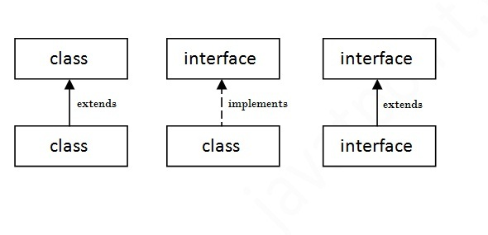
Understanding relationship between classes and interfaces
10-08-2023
Dr.R.Kayalvizhi, Assistant Professor / NWC

Slide 211
Simple example
interface Drawable{
void draw();
}
//Implementation: by second user
class Rectangle implements Drawable{
public void draw(){System.out.println("drawing rectangle");}
}
class Circle implements Drawable{
public void draw(){System.out.println("drawing circle");}
}
/Using interface: by third user
class TestInterface1{
public static void main(String args[]){
Drawable d=new Circle();//In real scenario, object is provided by method e.g. getDrawable()
d.draw();
}}
10-08-2023
Dr.R.Kayalvizhi, Assistant Professor / NWC

Slide 212
Multiple inheritance in Java by interface
If a class implements multiple interfaces, or an interface extends multiple interfaces i.e. known as multiple inheritance.
10-08-2023
Dr.R.Kayalvizhi, Assistant Professor / NWC

Slide 213
interface Printable{
void print();
}
interface Showable{
void show();
}
class A7 implements Printable,Showable{
public void print(){System.out.println("Hello");}
public void show(){System.out.println("Welcome");}
public static void main(String args[]){
A7 obj = new A7();
obj.print();
obj.show();
}
}
10-08-2023
Dr.R.Kayalvizhi, Assistant Professor / NWC

Slide 214
Defining an Interface
An interface is defined much like a class.
This is a simplified general form of an interface:
access interface name
{
return-type method-name1(parameter-list); return-type method-name2(parameter-list);
type final-varname1 = value;
type final-varname2 = value;
//... return-type method-nameN(parameter-list); type final-varnameN = value;
}
Here is an example of an interface definition.
It declares a simple interface that contains one method called callback( ) that takes a single integer parameter.
interface Callback
{
void callback(int param);
}
10-08-2023
Dr.R.Kayalvizhi, Assistant Professor / NWC

Slide 215
Implementing Interfaces
Once an interface has been defined, one or more classes can implement that interface.
To implement an interface, include the implements clause in a class definition, and then
create the methods required by the interface. The general form of a class that includes the implements clause looks like this:
class classname [extends superclass] [implements interface [,interface]]
{
// class-body
}
methods that implement an interface must be declared public.
10-08-2023
Dr.R.Kayalvizhi, Assistant Professor / NWC

Slide 216
class Client implements Callback {
// Implement Callback's interface
public void callback(int p) {
System.out.println("callback called with " + p);
}
}
Notice that callback( ) is declared using the public access modifier.
10-08-2023
Dr.R.Kayalvizhi, Assistant Professor / NWC

Slide 217
For example, the following version of Client implements callback( ) and adds the method nonIfaceMeth( ):
class Client implements Callback
{
// Implement Callback's interface
public void callback(int p)
{
System.out.println("callback called with " + p);
}
void nonIfaceMeth()
{
System.out.println("Classes that implement interfaces " + "may also define other members, too.");
}
}
10-08-2023
Dr.R.Kayalvizhi, Assistant Professor / NWC

Slide 218
Accessing Implementations Through Interface References
The following example calls the callback( ) method via an interface reference variable:
class TestIface
{
public static void main(String args[]) {
Callback c = new Client();
c.callback(42);
}
The output of this program is shown here:
callback called with 42
10-08-2023
Dr.R.Kayalvizhi, Assistant Professor / NWC

Slide 219
Notice that variable c is declared to be of the interface type Callback, yet it was assigned an instance of Client. Although c can be used to access the callback( ) method, it cannot access any other members of the Client class. An interface reference variable has knowledge only of the methods declared by its interface declaration. Thus, c could not be used to access nonIfaceMeth( ) since it is defined by Client but not Callback.
While the preceding example shows, mechanically, how an interface reference variable can access an implementation object, it does not demonstrate the polymorphic power of such a reference. To sample this usage, first create the second implementation of Callback,
shown here:
10-08-2023
Dr.R.Kayalvizhi, Assistant Professor / NWC

Slide 220
// Another implementation of Callback.
class AnotherClient implements Callback {
// Implement Callback's interface
public void callback(int p) {
System.out.println("Another version of callback");
System.out.println("p squared is " + (p*p));
}
}
Now, try the following class:
class TestIface2 {
public static void main(String args[]) {
Callback c = new Client();
AnotherClient ob = new AnotherClient();
c.callback(42);
c = ob; // c now refers to AnotherClient object
c.callback(42);
}
}
The output from this program is shown here:
callback called with 42
Another version of callback
p squared is 1764
10-08-2023
Dr.R.Kayalvizhi, Assistant Professor / NWC

Slide 221
Nested Interfaces
An interface can be declared a member of a class or another interface. Such an interface is called a member interface or a nested interface. A nested interface can be declared as public, private, or protected. This differs from a top-level interface, which must either be declared as public or use the default access level,
10-08-2023
Dr.R.Kayalvizhi, Assistant Professor / NWC

Slide 222
// A nested interface example.
// This class contains a member interface.
class A {
// this is a nested interface
public interface NestedIF {
boolean isNotNegative(int x);
}
}
// B implements the nested interface.
class B implements A.NestedIF {
public boolean isNotNegative(int x) {
return x < 0 ? false: true;
}
}
class NestedIFDemo {
public static void main(String args[]) {
// use a nested interface reference
A.NestedIF nif = new B();
if(nif.isNotNegative(10))
System.out.println("10 is not negative");
if(nif.isNotNegative(-12))
System.out.println("this won't be displayed");
}
}
10-08-2023
Dr.R.Kayalvizhi, Assistant Professor / NWC

Slide 223
Notice that A defines a member interface called NestedIF and that it is declared public.Next, B implements the nested interface by specifying
implements A.NestedIF
Notice that the name is fully qualified by the enclosing class’ name. Inside the main( ) method, an A.NestedIF reference called nif is created, and it is assigned a reference to a B object. Because B implements A.NestedIF, this is legal.
10-08-2023
Dr.R.Kayalvizhi, Assistant Professor / NWC

Slide 224
Variables in Interfaces
You can use interfaces to import shared constants into multiple classes by simply declaring an interface that contains variables that are initialized to the desired values.
When you include that interface in a class (that is, when you “implement” the interface), all of those
variable names will be in scope as constants
10-08-2023
Dr.R.Kayalvizhi, Assistant Professor / NWC

Slide 225
import java.util.Random;
interface SharedConstants {
int NO = 0;
int YES = 1;
int MAYBE = 2;
int LATER = 3;
int SOON = 4;
int NEVER = 5;
}
class Question implements SharedConstants {
Random rand = new Random();
int ask() {
int prob = (int) (100 * rand.nextDouble());
if (prob < 30)
10-08-2023
Dr.R.Kayalvizhi, Assistant Professor / NWC

Slide 226
else if (prob < 60)
return YES; // 30%
else if (prob < 75)
return LATER; // 15%
else if (prob < 98)
return SOON; // 13%
else
return NEVER; // 2%
}
}
class AskMe implements SharedConstants {
static void answer(int result) {
switch(result) {
case NO:
System.out.println("No");
break;
case YES:
System.out.println("Yes");
break;
case MAYBE:
System.out.println("Maybe");
break;
case LATER:
System.out.println("Later");
break;
case SOON:
System.out.println("Soon");
break;
case NEVER:
System.out.println("Never");
break;
}
}
public static void main(String args[]) {
Question q = new Question();
answer(q.ask());
answer(q.ask());
answer(q.ask());
answer(q.ask());
}
}
10-08-2023
Dr.R.Kayalvizhi, Assistant Professor / NWC

Slide 227
Here is the output of a sample run of this program. Note that the
results are different each time it is run.
Later
Soon
No
Yes
10-08-2023
Dr.R.Kayalvizhi, Assistant Professor / NWC

Slide 228
Interfaces Can Be Extended
One interface can inherit another by use of the keyword extends. The syntax is the same as for inheriting classes. When a class implements an interface that inherits another interface, it must provide implementations for all methods required by the interface inheritance chain.
Following is an example:
10-08-2023
Dr.R.Kayalvizhi, Assistant Professor / NWC

Slide 229
// One interface can extend another.
interface A {
void meth1();
void meth2();
}
// B now includes meth1() and meth2() -- it addsmeth3().
interface B extends A {
void meth3();
}
// This class must implement all of A and B
class MyClass implements B {
public void meth1() {
System.out.println("Implement meth1().");
}
public void meth2() {
System.out.println("Implement meth2().");
}
public void meth3() {
System.out.println("Implement meth3().");
}
}
class IFExtend {
public static void main(String arg[]) {
MyClass ob = new MyClass();
ob.meth1();
ob.meth2();
ob.meth3();
}
}
10-08-2023
Dr.R.Kayalvizhi, Assistant Professor / NWC

Slide 230
Static Method in Interface
interface Drawable{
void draw();
static int cube(int x){return x*x*x;}
}
class Rectangle implements Drawable{
public void draw(){System.out.println("drawing rectangle");
}
}
class TestInterfaceStatic{
public static void main(String args[]){
Drawable d=new Rectangle();
d.draw();
System.out.println(Drawable.cube(3));
}}
10-08-2023
Dr.R.Kayalvizhi, Assistant Professor / NWC

Slide 231
Difference between abstract class and interface
abstract class | Interface
1) Abstract class can have abstract and non-abstract methods. | Interface can have only abstract methods. Since Java 8, it can have default and static methods also.
2) Abstract class doesn't support multiple inheritance. | Interface supports multiple inheritance.
3) Abstract class can have final, non-final, static and non-static variables. | Interface has only static and final variables.
4) Abstract class can provide the implementation of interface. | Interface can't provide the implementation of abstract class.
5) The abstract keyword is used to declare abstract class. | The interface keyword is used to declare interface.
6)Example: public abstract class Shape{ public abstract void draw(); } | Example: public interface Drawable{ void draw(); }
10-08-2023
Dr.R.Kayalvizhi, Assistant Professor / NWC

Slide 232
//Creating interface that has 4 methods
interface A{
void a();//bydefault, public and abstract
void b();
void c();
void d();
}
//Creating abstract class that provides the implementation of one method of A interface
abstract class B implements A{
public void c(){System.out.println("I am C");}
}
//Creating subclass of abstract class, now we need to provide the implementation of rest of the methods
class M extends B{
public void a(){System.out.println("I am a");}
public void b(){System.out.println("I am b");}
public void d(){System.out.println("I am d");}
}
//Creating a test class that calls the methods of A interface
class Test5{
public static void main(String args[]){
A a=new M();
a.a();
a.b();
a.c();
a.d();
}
}
10-08-2023
Dr.R.Kayalvizhi, Assistant Professor / NWC

